Slide 1



IMPACT INVESTING
Presented to Northeast Michigan Estate Planning Council
September 26, 2019

Slide 2


COUNCIL OF MICHIGAN FOUNDATIONS
The Council of Michigan Foundations is a community of philanthropists committed to improving outcomes for Michigan, and beyond. Through investing in the state's charitable organizations, convening business, government and nonprofit leaders, collaborating on critical issues, seeking innovative solutions, sharing knowledge and advocating, we leverage our collective voice to increase the impact of Michigan philanthropy.

Slide 3
CMF MEMBERS
Private Foundations
Corporate foundations and corporate giving programs
Family foundations
Independent foundations
Public Foundations
Community foundations, affiliates, and donor-advised funds
Public charities

Slide 4
HOW MANY FOUNDATIONS ARE THERE IN MICHIGAN?*
Total number of foundations: 2,181
Total assets: $23.1 Billion
Annual giving: $1.6 Billion
Annual gifts received: $1.7 Billion
*As of 2015

Slide 5
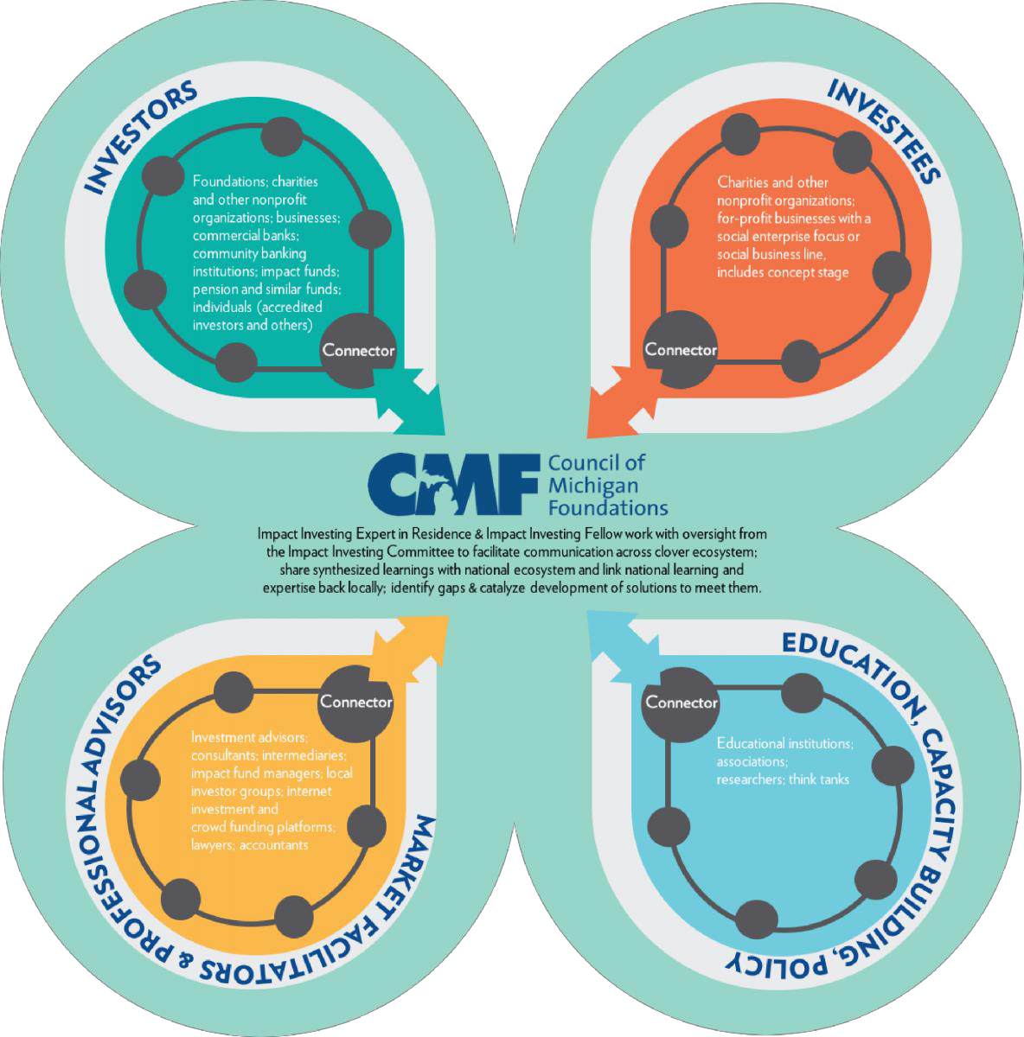
IMPACT INVESTING HUB

Slide 6

WHAT IS IMPACT INVESTING?
Investments made with the intention to generate positive, measurable social and environmental impact alongside a financial return.
Made in both emerging and developed markets as well as across
all asset classes, including private and public markets.
Target a range of financial returns from below market to market
rate, depending on their strategic goals.
-Global Impact Investing Network

Slide 7
WHY IMPACT INVESTING?
Investments can — and should — also seek to fuel meaningful, sustainable social and environmental impact.
The worlds most pressing needs require real capital to effect change.
Philanthropic shift from charity to investment

Slide 8

WHO IS IMPACT INVESTING?
Global impact investing market: $502 billion under management by 1,340 organizations.
58% of organizations located in the U.S. 21% are in Europe
  asset managers, foundations, banks, development finance institutions, family offices, pension funds, insurance companies
-Global Impact Investing Network

Slide 9
HOW TO DO IMPACT INVESTING
Invest through intermediary or fund:
Invest in publicly traded fixed income securities
Make a loan to a Community Development Financial Intermediary
Provide a guarantee
Direct investments:
  Directly making loans
  Operating revolving loan funds
  Funding pay for success programs
  Making direct equity investments

Slide 10

IMPACT INVESTING IN THE COMMUNITY

Slide 11
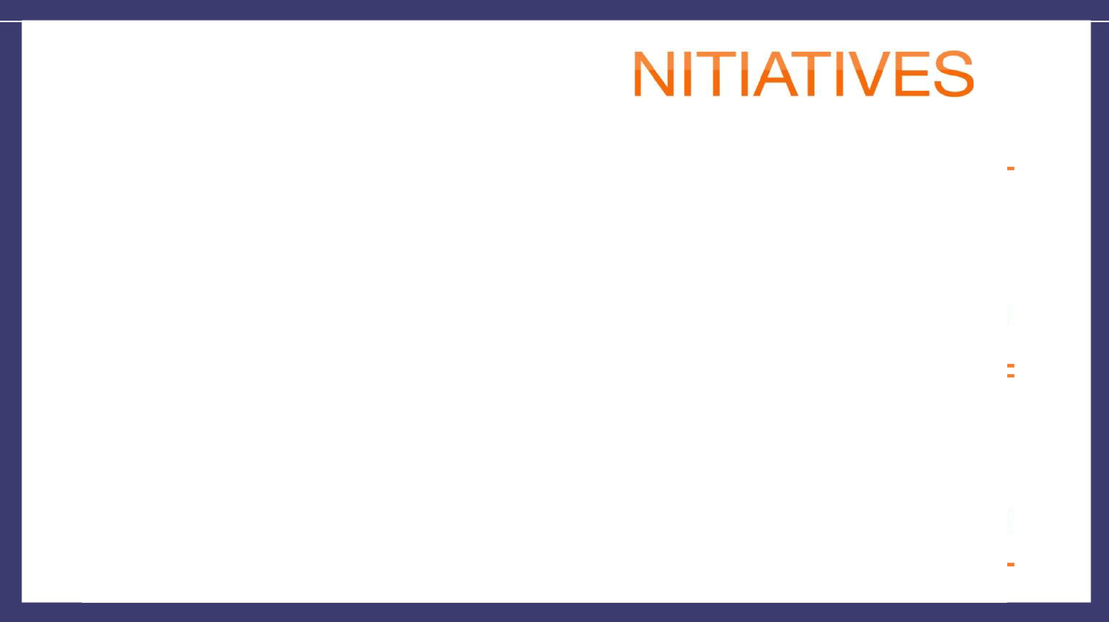



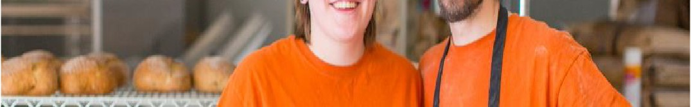


NO RTHER
I
Money and Know How
TOP INDUSTRIES SERVED
0/
OF OUR CUSTOMERS ARE START· UPS
U/0
no,
26%1b
0 -.,,.,,mr-
:s:
_{z}t.:,
24%
---
ci2
::,
I_{u}-
.<.⁽ .
::,
z
<(
::;:
22% II
OF OUR CUSTOMERS
ARE WOMEN OWNED
U/0
.-.....

Slide 12
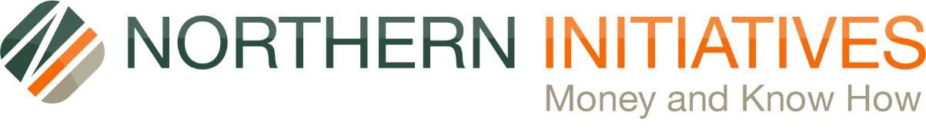
The 5 C’s of Credit
  Credit (700 or above)
  Collateral (1.2 x loan)
  Cash (20% equity)
  Character
  Capacity (sufficient cash and surplus to repay debt monthly)
Plus 2
  Compassion
  Courage

Slide 13
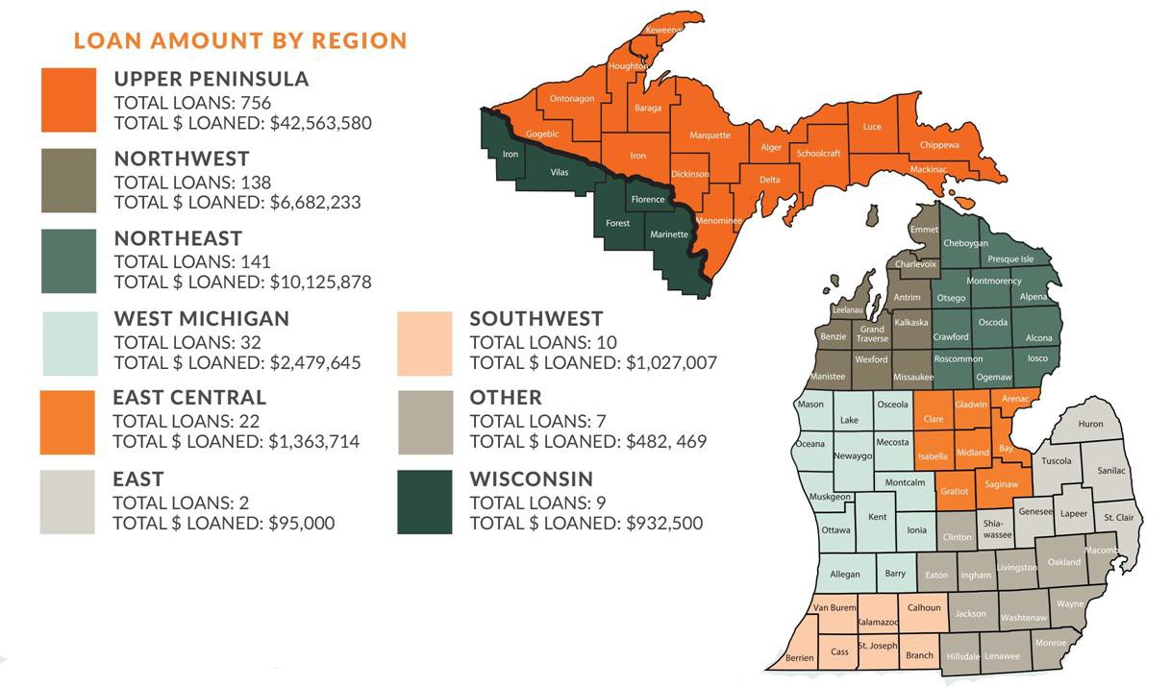
CUMULATIVE LOAN ACTIVITY 1994-2018

Slide 14

MAX M. & MARJORIE S. FISHER FOUNDATION & IMPACT INVESTING
The Foundation seeks to expand our impact by investing 3.6% of our assets through:
Program Related Investments (PRIs) and
Mission Related Investments (MRIs).
Together with our partners, we:
Lead alongside others by investing in individual deals to build the field of impact investing.
Learn through participating in collaborative investments with seasoned impact investors.
Accelerate the field by investing in opportunities that create on-ramps for new impact investors.
“If you are not optimistic, it will never happen.”
— Max M. Fisher
14

Slide 15

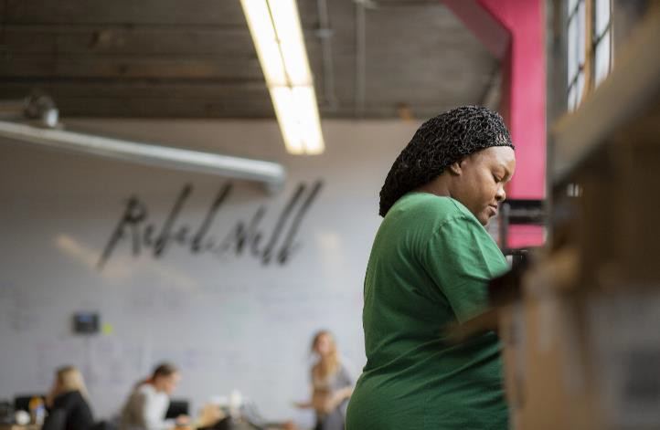
FISHER FOUNDATION & REBEL NELL
“All giving starts with your heart, and then you use your head”
—Marjorie S. Fisher
The Foundation’s partnership with Rebel Nell is one of our most successful PRIs to date.
Partnering with local programs, Rebel Nell recruits and employs workforce-ready women, developing their skills in jewelry making while also offering wraparound services.
The company was the recipient of a $195,000
PRI in 2017 and a second PRI in 2018 of
$195,000.
Title of Slide Here

Slide 16


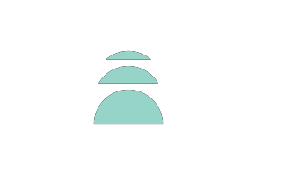
Breaking Through Barriers to Liberate Potential
www.RebelNell.com

Slide 17
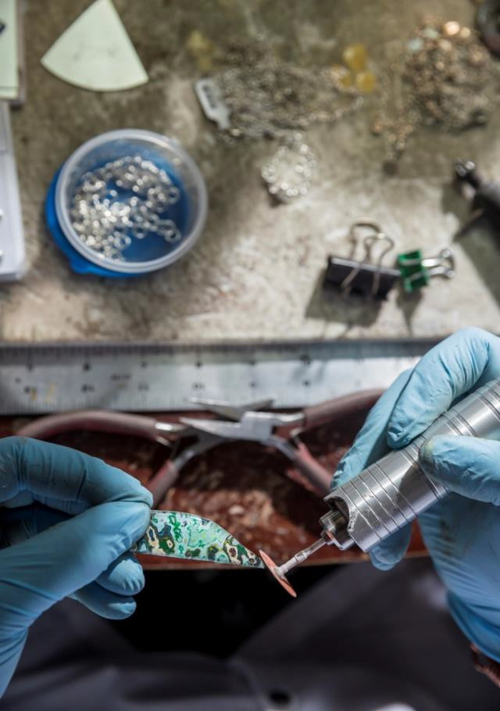
WHO ARE WE:
Rebel Nell is a jewelry manufacturing company created For women who have faced chronic joblessness and homelessness and who need a supportive workplace and tailored programming to attain an independent and self-sufficient life. Rebel Nell provides employment, education and empowerment to leave joblessness and homelessness behind permanently.
Product:
Unique, One-of-Kind Jewelry Made from Fallen Graffiti

Slide 18


The Problem:
Many women in Detroit are economically disadvantaged and often find themselves without a home or support system, dependent on government subsidies, and confined to a life with little, if any opportunity to break the cycle. These women need job training and work experience to help them leave homelessness behind permanently and move towards a self-sustaining and independent life.
19,213 total homeless people were counted in the Detroit area in 2011.
7,724 or 40% were women.
85% of homeless were unemployed.
82% of families were single mothers with children.
80% of homeless adults in families were unemployed at the time they became homeless.

Slide 19

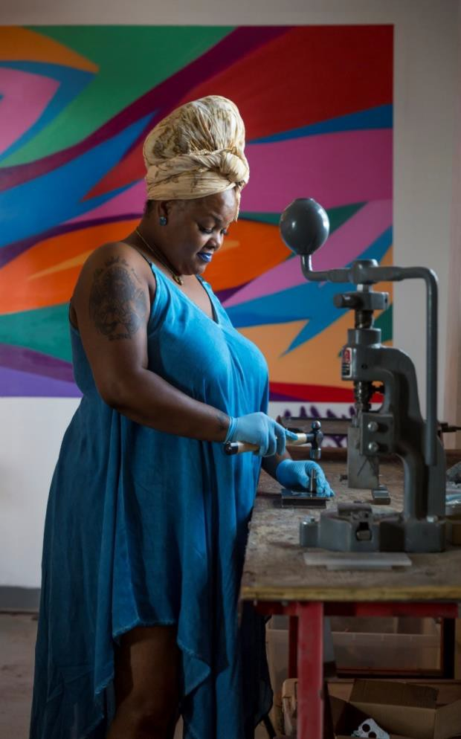
Solution:
Rebel Nell provides a holistic and individualized approach to address many of the challenges that have been a barrier to self- sufficiency. This includes employment by teaching them a marketable skill (jewelry making), education classes, housing and transportation assistance, and provides an overall support system.

Slide 20
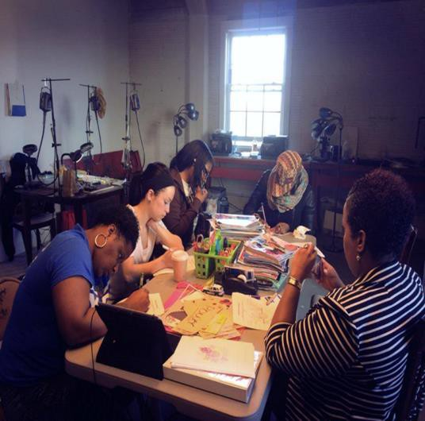
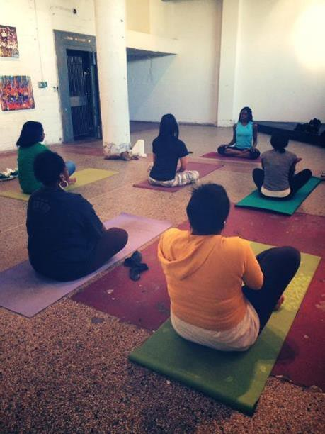
Supportive Services:
Women’s empowerment classes, business growth classes, financial literacy classes, vision board classes, strength finding, understanding work hours, legal assistance i.e. restoring drivers license, car purchases, housing support, scholarship assistance for their kids to attend summer camps, above minimum wage jobs, interest free loans, etc…

Slide 21
HOW IT WORKS
Hire Women from Shelter
Outputs
Long Term
Impact
Program Model
Outcomes
Hire women who have faced chronic joblessness. We remove barriers to employment that have been prohibitive in the past i.e. background checks. We rely on case workers at shelter
Provide training and employment to make jewelry.
Earn up to $12 an hour wages,
Participate in business education, personal development, life wellness and other supportive services.
Access to resources
Women Develop
Life Skills
Work Readiness
Family Stability
Housing
Understanding Finances
Confidence
Changed mindset
Employees that break the cycle of re-incarceration
Stronger home life that will transfer to the generations that follow
Employment opportunities for wage growth
Minimize generational poverty
Increase number of contributing citizens in Detroit
Increase talent in the workforce
Reduced recidivism

Slide 22
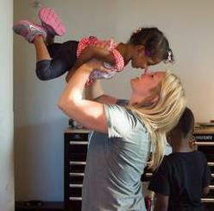
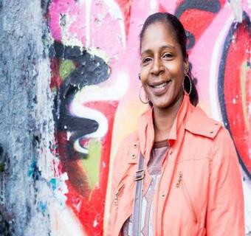
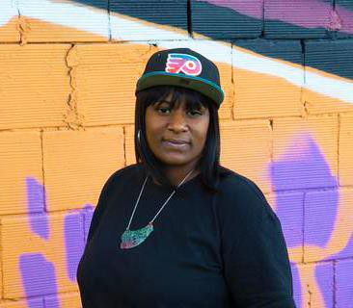

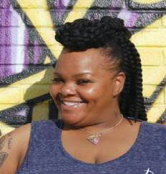
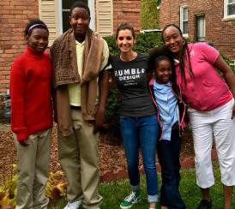
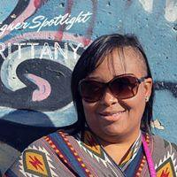
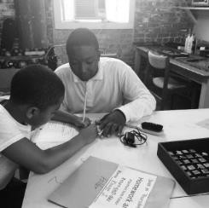
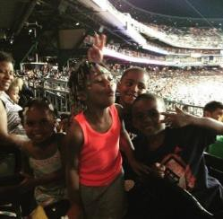
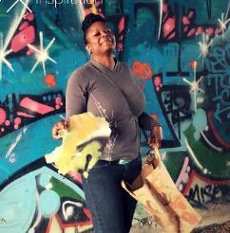

Our Impact to Date:
Number of lives impacted: 23 direct hires (88 including immediate family)
9 graduates who were able to transition into traditional workforce
All of our hires have avoided going back to shelter living
0% rate of recidivism
Improved credit score to allow for car or education loans
100% repayment of micro-loans
Overall improvement in quality of life
Stronger family units
Household income raised by $1,254

Slide 23

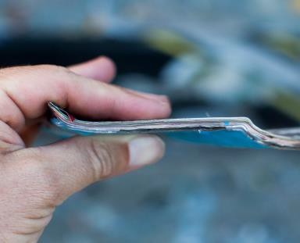
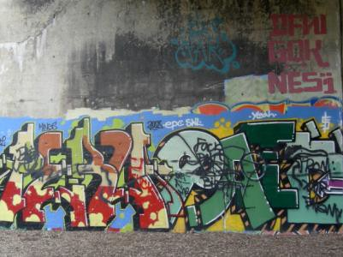
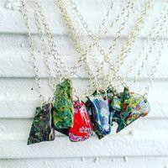
OUR PRODUCT: JEWELRY FROM FALLEN GRAFFTI
We collect graffiti once it crumbles off the walls in Detroit. Through a special trade secret process, we are able to reveal the layers that make up a particular piece of graffiti and turn it into wearable art. The ladies we hire have complete creative freedom to express their vision and voices through each piece by selecting the design and color patterns. Each piece is truly one-of-a-kind.

Slide 24

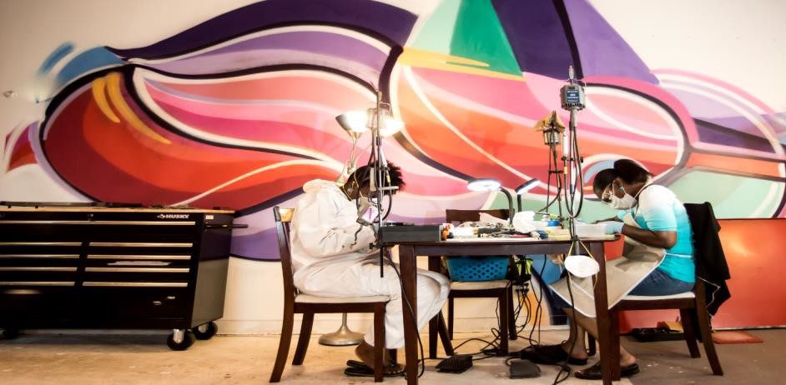
Our objective is to be a profitable social enterprise where our product sales of jewelry made from fallen graffiti (or other repurposed material) will provide for all of the educational and supportive programming we offer our hires. As of 2018 were 85% sustainable.

Slide 25
MORE THAN ONE WAY TO LEAVE A LEGACY
Build wealth that also positively impacts the world
Passes along values to next generation
https://www.michiganfoundations.org/impact-investing

Slide 26

Thank
You!
Council of
Michigan
Foundations

