Slide 1
ACP in the “Real World”

Slide 2
Video
https://www.youtube.com/watch?v=J1r0Xbh0UVo
Notes:
Start with a video demonstrating the power of conversation
***Ask audience to share stories, or share our own:
-my grandfather
-family that had AD for years but no conversation sitting with me to review/revise
…so what is ACP?

Slide 3
“Let’s Pretend”
If you had a medical emergency today…
Who would speak for you?
Would they know what to say?
Notes:
Emergency – who would speak – would they know what to say – how make them feel
**Example - Casey

Slide 4
ACP is MORE than a Document
Early
Ongoing
Record and TALK
Notes:
ACP is more than just checking boxes on a form and signing a document…as a matter of fact, we don’t want this to be a one and done document completion for the patient – we want everyone to start thinking about ACP as a process – that should begin when the patient is young and healthy and continue on throughout the course of their lifetime – changing their plan as their health conditions change and as they experience other deaths in their lives.
IN ADDITION to documenting your preferences in an AMD/DPOA-H, it involves TALKING with your family, friends, spiritual leaders and healthcare providers about your thoughts and wishes
***this talking piece is incredibly important. – failure when slap a name on a document – leaves loved ones guessing about what they really want because they haven’t been empowered**grandfather story – no longer making choices, you are voice
Advance Directives (ADs) are only as good as the process of planning:
If the person planning does not understand, reflect on, or discuss their choices/options adequately, the plan has a high probability of failure.
ADs success is directly tied to the quality of the planning process or ACP.

Slide 5
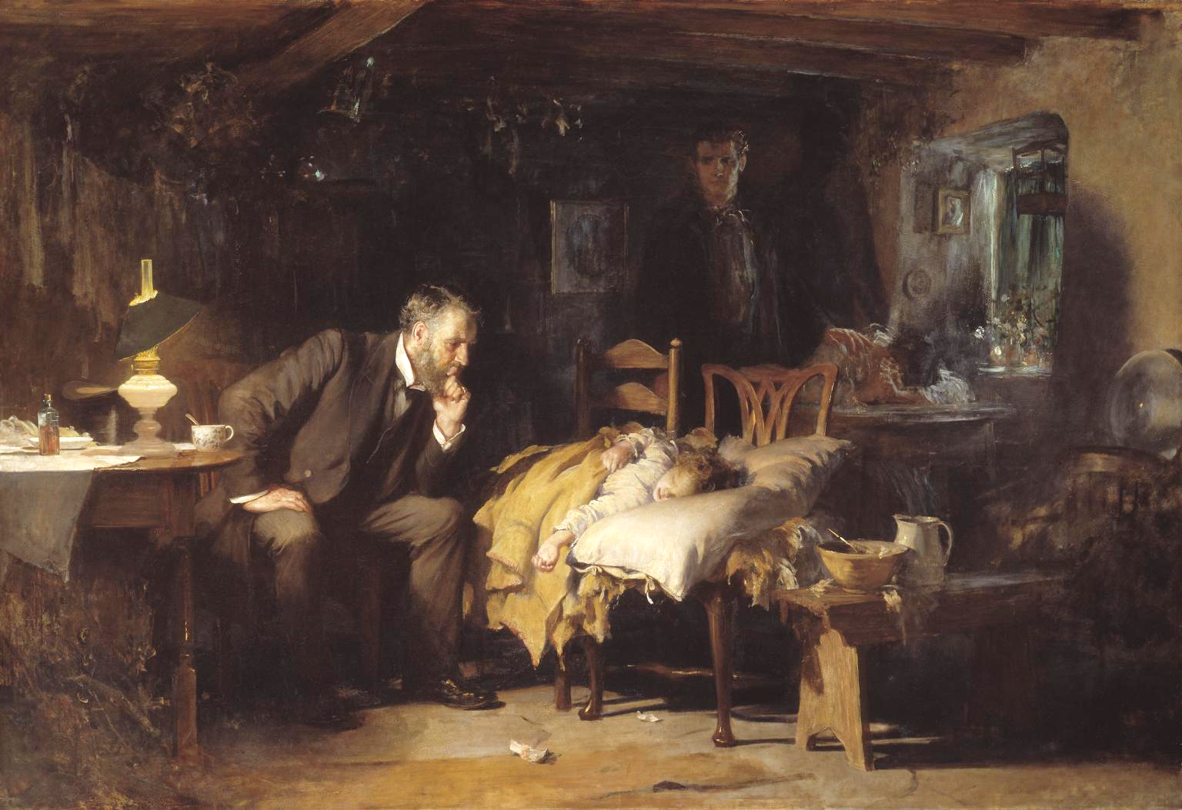
Advance
Care
Planning
Notes:
ACP – each letter on slide showing single
A: Melissa Community garden and analogy
C: to get specific care in a proven scientific based method
P: planning vs just talking about it – useable plan in a document form
Goal is to create an advance care planning document that will serve as a record of decisions and wishes . (including the designation and acceptance of patient advocate). Useable document that translates patients’ goals and decisions into written plan to guide clinical decision making.
****This is the process of having individuals, families, and their health care providers talk about what they want their lives to look like as they get sick or old***
It involves educating patients about their future medical options….
**To be effective, needs to meet similar standards as the process of informed consent, i.e., the person planning needs to:
Understand what they really are and what they look like
Evaluate and reflect their choices in light of their own values and goals

Slide 6
Program History
2000-2012
Oct 2014
Jun 2015
2017
Today
Future
Notes:
Timeline document content
-Informal group early 2000’s
-2012 formalized steering committee
-Oct 2014, health system endorsement approval to hire ACP Specialist, chose RC method – briefly why
-from hire date - single resource document, program method chosen and pilot began June 2015
-collaborative efforts 2017 was a big year: EPIC **easy access and total ACP storage space**- April MACF, August MPCC statewide, MiHIA collaboration population health team interest **Covenant and I are co-chairs for MiHIA, introduce Tracy in the audience
-Now – continuing to improve steering committee membership, almost 60 facilitators, MiHIA 2018 Pop Health Team focus, ACP Michigan website
-goals, current facilitators, future
Facilitators set this system apart from others that stress conversation- **list some of the community partners and highlight RN CM, healthcare staff ****refer to me – central intake
Goals of program: community and staff education and engagement, community collaboration and growth – specifically faith based??

Slide 7
Document Applications
Letters of Guardianship
DPOA-H/Designation of Patient Advocate
Advance Medical Directives
Inability to Participate
DNR order
POST
Notes:
Guardianship – limited or plenary; financial or medical A developmentally disabled adult with a court appointed guardian can only authorize a FULL Code.
DPOA-H/Designation – name individual(s) to act on behalf if lack capacity/ability to participate in care.
AMD - documents pertaining to treatment preferences and the designation of a patient advocate in the event that a person should become unable to make medical decisions on their own behalf.
***many DPOA-H/Designation forms are a combination between the two aforementioned documents***
Inability to participate (In Medical Treatment Decisions) – 2 physicians/1 physician and 1 licensed psychologist **no mid-level providers** Patient advocate may be able to revoke and the patient may be able to revoke who pt advocate is
DNR- medical order written by physician stating that CPR should not be started if the person is found pulseless and breathless
POST – Physicians Orders for Scope of Treatment – Used by Emergency Response Personnel, as well as medical facilities
**11/8/17, House Bill 4170 was signed into law as Public Act 154
This law establishes Physician Orders for Scope of Treatment (POST) as a legal tool that communicates the decisions a seriously-ill Individual, or his/her Patient Advocate or Court-appointed Guardian, makes about the care he/she does and does not desire, should there be a medical crisis in which the individual cannot express these decisions.
“The POST form is intended to be used as part of an advance care planning process. The POST form is not intended to be used as a stand-alone advance health care directive that unilaterally expresses the patient’s medical treatment wishes. The POST form contains medical orders that are jointly agreed to by the patient and the attending health professional or the patient representative and the attending health professional. The medical orders on the POST form reflect both the patient’s expressed wishes or best interests and the attending health professional’s medical advice or 4 recommendation. An advance care planning process that uses the POST form must recommend that the patient consider designating an individual to serve as the patient’s patient advocate to make future medical decisions on behalf of the patient if the patient becomes unable to do so.”
The Department of Health and Human Services shall convene an ad hoc advisory committee to create a standard POST form and procedures, within 90 days after the effective date for this act.
• Within 180 days of convening, the committee shall make recommendations to the department: There shall be a single, standardized POST form, other procedural decisions

Slide 8
65%-76% of physicians are
Unaware ACP documents exists
Notes:
****should I do 23% then 65-67%***????
According to a 2011 study performed by the Centers for Disease Control and Prevention:
…only 1/3 of our nation has one of these documents, even though over 70% of …and of those who have them:
Between 65 and 76 percent of physicians whose patients had an advance directive were not aware that it existed (Kass-Bartelmes 2003).
Physicians are unaware that documents exist because of improper storage. Commonly stored in a file cabinet or safe-deposit box:
Hospital/Physician(s)
Patient Advocate
Family/Friends
EMS

Slide 9
Take Aways
Importance of conversation in planning
Resources available
Notes:
Feeling once that person is gone – grief compounded when not prepared

