Slide 1
As of 3/16/2018
Understanding Social Security
Kit Mac Nee, CFP®, CRPC®
Financial Advisor
April 25, 2019
Notes:
Welcome to our seminar, Understanding Social Security. I am pleased you took time out of your busy day to attend this seminar. My name is __________. I am a Financial Advisor with Morgan Stanley.
Today / tonight, we’re going to talk about one of the best retirement plans ever created…Social Security.
If you could create the ideal retirement plan, what would it look like? Would it provide you with guaranteed income for the rest of your life? Would it offer increases to keep up with inflation? Would it involve no investment risk on your part?
Social Security does all this and more. Our goal today / tonight is for you to leave here with an understanding of how your benefits are calculated, when you can – or should – collect them, and whether Social Security, combined with your other sources of income, will be enough to sustain perhaps 20-30 years of retirement.

Slide 2

Today’s Agenda
    The Basics of Social Security
    Deciding When to Receive Benefits
    Benefits Beyond Retirement
    Planning Your Retirement Strategy
Notes:
Today, we will cover a number of important topics about Social Security.
We’ll start with a brief overview of the basics of Social Security.
We’ll then spend some time talking about how to decide when to begin receiving benefits. We’ll also cover benefits of Social Security beyond being a source of income in retirement.
Finally, we’ll talk about how to get started on planning your retirement strategy with Social Security in mind.
Let’s get started. . .

Slide 3
Social Security Fun Facts
Officially, the first Social Security number issued was 055-09-0001 and was assigned to John David Sweeny. Sweeny died of a heart attack in 1974 at the age of 61; ironically, he never received a single penny of Social Security.
Ida May Fuller was the first recipient of a monthly Social Security check. She began receiving checks on January 31, 1940 for $22.54 monthly. By the time of her death, Ida May had collected $22,888.92 from Social Security benefits, compared to her contributions of $24.75 into the system.
More than $40,000 people have claimed 078-05-1120 as their number. It’s the number a wallet manufacturer used on the fake cards that used to come in new wallets.
Prior to 2011, the first three digits of a Social Security number denoted the area in which you lived at the time the card was applied for. The numbers increase from east to west across the United States. That no longer happens.

Slide 4
Top 12 Things to Know About Social Security
Most people get back more than they put in
Social Security is not just a retirement program
Social Security has gone digital – https://www.ssa.gov/myaccount
You can work and get Social Security
The purchasing power of Social Security is diminishing
Social Security is not meant to be the sole source of income.
AARP Bulletin November 2018

Slide 5
Top 12 Things to Know About Social Security
Social Security is not going bankrupt.
Congress will not examine Social Security anytime soon
Ideas to reform funding are starting to take shape
Law makers do not raid the trust fund.
Many believe it can be run better
Social Security benefits can be taxed
*AARP Bulletin November 2018

Slide 6
How Does Social Security Fit Into Retirement?
What is the average life expectancy for a 65 year old woman? A 65 year old man?
  80/76
  86/84
  76/72
  92/87
Almost half of unmarried women over age 65 rely on Social Security for what percentage of their income?
  60%
  70%
  80%
  90%
Widows age 60 & older can receive what percentage of their husband’s social security benefit?
  100%
  80%
  60%
  40%
Women generally receive greater Social Security benefits than men?
  True or False
Delaying retirement can increase the amount of Social Security benefits you receive.
  True or False

Slide 7
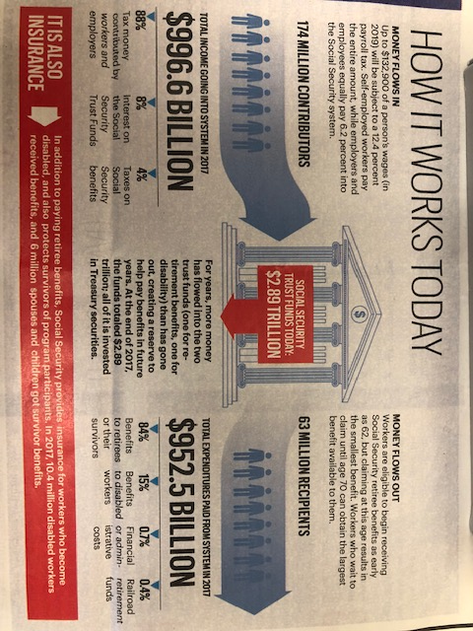
How Does Social Security Work ?
AARP Bulletin January 2019

Slide 8
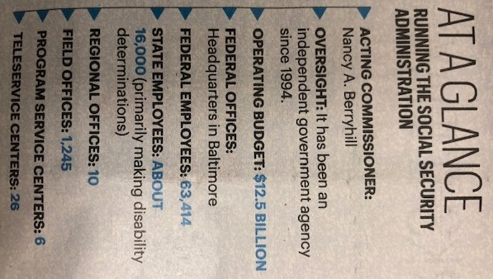
Social Security Administration
AARP November 2018

Slide 9

To What Degree Do American’s Rely on Social Security?
Signed into law by Franklin D. Roosevelt in 1935, Social Security was created to mitigate the risks for workers in an increasingly industrialized economy. Over time, it came to be seen as one leg of a “three legged stool of retirement” (pensions and savings were the others). With pensions vanishing and the savings rate dismal, millions of retirees now rely on Social Security of a big slice, if not most of their income.
The average monthly check is $1,413 ($16,956 per year). For about one in three older people receiving benefits, that check accounts for 90 percent of income, according to the Social Security Administration.
Pension
Social
Security
Savings

Slide 10
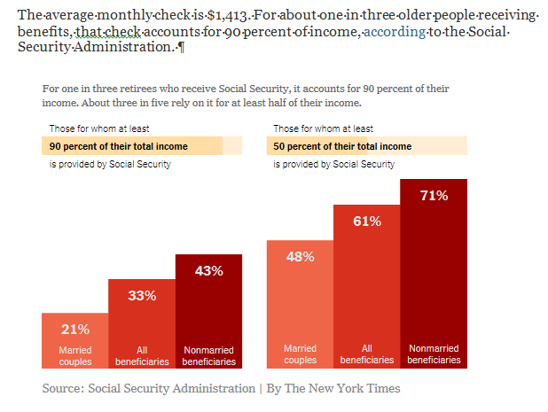
How Much Do Americans Rely on Social Security?

Slide 11
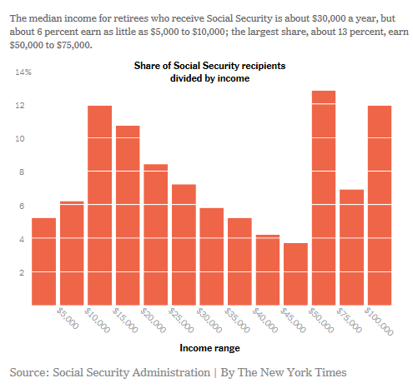
Incomes of Social Security Recipients

Slide 12
The Basics of Social Security
SECTION 1
Notes:
Understanding how Social Security works can help you determine whether you’ll be able to retire on schedule and whether you will require additional income in retirement.
Let’s begin with the basics.

Slide 13
What Is Social Security?
  Social Security provides a safety net for eligible Americans that can supplement a pension, personal investments and savings.
    Your Social Security benefits are a key piece in your retirement plan
    You can start collecting Social Security benefits prior to or after reaching your full retirement age
Sources of Retirement Income ⁽¹⁾
Government
Employee Pensions
Other
Private
Pensions
Social
Security
Asset
Income
Earnings
“Fast Facts & Figures About Social Security, 2017,” Social Security Administration.
Notes:
So, what is Social Security?
Developed in 1935, Social Security is a federal insurance program that provides benefits to older Americans, workers who become disabled and families in which a spouse or parent dies. In essence, Social Security provides a safety net for eligible Americans that can supplement a pension, personal investments and savings.
As you can see from the chart, Social Security is among the primary sources of retirement income for Americans over the age of 65.
Your Social Security benefits are a key piece in your retirement plan, and you can start collecting Social Security benefits prior to or after reaching your full retirement age.

Slide 14

What can Social Security Cover
Many people think Social Secuirty will cover most of their expenses in retirement, but the truth is that it will provide about 32% of retirement income.
*LIMRA Retirement Income Reference Book, 2012. “Sources of Retirement Income study”, LIMRA 2011

Slide 15
Purpose of Social Security
  Social Security was intended to supplement other sources of income during retirement; however, it has become an important source of income for many Americans.
For 34% of
retired Americans
For 62% of
retired Americans
Social Security provides
90% or more of their income ⁽¹⁾
Social Security provides
50% or more of their income ⁽¹⁾
“Fast Facts & Figures About Social Security, 2017,” Social Security Administration.
Notes:
Although Social Security was originally intended to supplement other sources of income during retirement, it has become an important source of income for many retired Americans.
For 34 percent of retired Americans, Social Security provides 90 percent or more of their income.
For 62 percent, Social Security accounts for 50 percent or more of their income.

Slide 16
Qualifying for Social Security Benefits
  When you work and pay Social Security taxes, you earn a minimum of four credits, or building blocks, per year toward your benefits.
Monthly benefits are based
on your lifetime earnings.
To qualify, you must
accumulate a minimum of 40 credits, or 10 years of work.
Limits on maximum amount of earnings used to calculate benefit ($128,400 for 2018).
Social Security Fact Sheet, http://www.socialsecurity.gov, 2017, 2018 Social Security Changes Fact Sheet https://www.ssa.gov/news/press/factsheets/colafacts2018.pdf.
For those born 1929 or later.
Notes:
Social Security is financed through a dedicated payroll tax called FICA, which stands for Federal Insurance Contributions Act. FICA taxes are withheld from your paycheck, and your employer makes contributions, as well.
When you work and pay Social Security taxes, you earn a minimum of four credits, or building blocks, per year toward your Social Security benefits.
To qualify for Social Security, you must accumulate a minimum of 40 credits, or 10 years of work.
The more you earn, the more FICA you pay into the system and the larger your benefits will be at retirement. Of note, there is a limit to the maximum amount of earnings used to calculate your Social Security benefit. In 2018, that maximum is $128,400. That number is adjusted for inflation each year.

Slide 17
Calculating Social Security Benefits
YEARS
WORKED
PIA
FICA OR
SECA PAID
INTO THE SYSTEM
AMOUNT
OF
EARNINGS
Notes:
So how much can you actually expect to receive once you’re ready to retire?
Your benefits are a function of your earnings history – how many years you’ve worked, how much you’ve earned and how much you’ve paid into the system.
The benefit that is calculated from all these variables is called your Primary Insurance Amount, or PIA. Your PIA is the amount you are eligible to receive in Social Security benefits when you reach Full Retirement Age, or the age at which you’re entitled to receive full benefits.

Slide 18
Same Sex Marriages
Married same-sex couples now get Social Security benefits
Same-sex married couples are eligilble for Social Security spousal and survivor benefits
  Couples living in a state that previsouly did not recognize same-sex marriages can apply for benefits
  Non-married spouses also may be eligible for spousal benefits
A surviving spouse qualifies for the one-time lump-sum death benefit to help pay for expenses.
More information at
www.ssa.gov/same-sexcouples

Slide 19
Provisional Income
50% Social Security Benefits
Income from Municipal Bonds
Wages
Business Income
Interest
Capital Gains
Dividends
Traditional IRA Distributions
Rental Income
Annuity Income
Pensions
May not include:
Tax-deferred balances inside IRAs, 401(k) and annuities
Income from Roth IRAs
Non-taxable income from life insurance

Slide 20
Social Security: Full Retirement Age (FRA)
  The Social Security Administration determines your full retirement age, i.e., the age you’re entitled to receive full benefits.
NORMAL
RETIREMENT AGE
AT AGE 62 RETIREMENT BENEFIT IS REDUCED BY
YEAR OF BIRTH
1943 – 1954
1955
1956
1957
1958
1959
1960 or later
66
66 and 2 months
66 and 4 months
66 and 6 months
66 and 8 months
66 and 10 months
67
25.00%
25.83%
26.67%
27.50%
28.33%
29.17%
30.00%
http://www.socialsecurity.gov/retire2/agereduction.htm (2018).
Notes:
Your Full Retirement Age, or FRA, is determined by the Social Security Administration, and it is the age at which you are eligible to receive your full PIA.
As you can see from this chart, the definition of Full Retirement Age depends on when you were born.
Anyone born between 1943 and 1954 has a Full Retirement Age of 66, and anyone born in 1960 or later has a Full Retirement Age of 67.
You can elect to take benefits as early as age 62, or wait until as late as age 70. However, if you decide to take benefits early, you will only receive a percentage of your PIA. As you can see from this chart, if you were born in 1960 or later, your retirement benefit is reduced by 30 percent if you elect to take benefits at age 62.

Slide 21
When Can You Collect Social Security?
  You don’t automatically begin receiving benefits once you retire. You must apply online, by calling
  1-800-772-1213 or by visiting a Social Security Office.
FULL RETIREMENT AGE
Age at which you are entitled to full retirement benefits, which depends on your
year of birth.
EARLY RETIREMENT
You may begin receiving benefits at age 62, but benefits will permanently be reduced by 25% – 35% depending on year of birth.
DELAYING RETIREMENT
For those born in 1943 or after, an additional 8% is credited to your permanent benefit each year until you reach age 70.
Notes:
Let’s talk a little bit more about when you can collect Social Security.
You don’t automatically begin receiving benefits once you retire. You must either apply online, call the Social Security Administration or visit a Social Security Office.
You have the option to choose when to start collecting your benefits.
As I mentioned earlier, you may choose to start collecting benefits at Full Retirement Age, the age at which you are entitled to full retirement benefits.
Or, you may choose to take early retirement and begin receiving benefits at age 62, but your benefits will be permanently reduced by 25 to 35 percent, depending on when you were born. Keep in mind that, once you begin taking early benefits, you can’t change your mind.
You may also choose to delay retirement. If you were born in 1943 or later, an additional 8 percent of delayed retirement credits are added to your permanent benefit each year until you reach age 70.

Slide 22
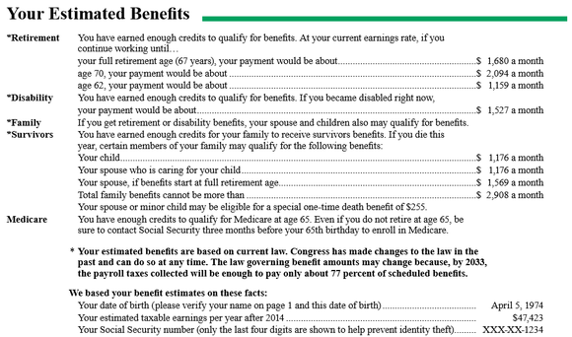
Your Estimated Benefits Statement
For Illustrative Purposes Only
Contact Social Security Administration at 1-800-772-1213 or visit www.ssa.gov
Notes:
Let’s look at a hypothetical example. Here is a sample Social Security Benefits Statement. Does this look familiar?
You receive this Statement from the Social Security Administration every year approximately three months before your birthday. If you’ve somehow misplaced yours or don’t remember receiving it, you can obtain another by calling the Social Security Administration or visiting their website at www.ssa.gov.
The Statement is not intended to provide you with an exact projection of the benefits you will receive at retirement. It is based on your earnings and FICA contributions to date. And, it assumes you’ll continue to maintain your current earnings level until you retire. However, it will help you determine more or less what you can expect from Social Security and whether your overall retirement income strategy is on track or requires some adjustment.
Let’s take a closer look at the sample benefits statement.
<click to advance> This particular statement shows that its recipient – let’s call him John – has paid enough FICA over his career to qualify for a monthly benefit of $1680 at Full Retirement Age. For John, Full Retirement Age is age 67.
Notice that the Statement also projects a monthly benefit at two other ages – age 62 and age 70.
<click to advance>
If John wishes, he can opt for a lower monthly payment of $1159 a month at age 62. Or, he can wait until he reaches age 70 to begin receiving a higher benefit of $2094 a month.

Slide 23
Windfall Elimination Provision
Calculating a reduction in individual benefits
Who may be affected?
Individuals who earned a pension and did not pay Social Security taxes and are eligible for Social Security benefits based on their earnings and work history.
A modified formula is used to calculate PIA
    It reduces replacement rate of 90% of the first $885 to 40%
  Maximum reduction in 2017 is 442.50 or 50% of pension, whichever is less
  WEP reduction may be as low as $0
Calculating WEP
WEP
40% -90% of the first Average
Indes Monthly Earnings (AIME)
$885
+
32% of AIME $885
Through $5,336
+
15% of AIME over $5,336

Slide 24
Your pension could reduce your spousal or survivor benefits
Pension
$1500
Offset
$1,000
x
2/3
=
Spousal Benefits
$1,100
Survivor Benefits
$2,200
$100
$1,200

Slide 25
Deciding When to Receive Benefits
SECTION 2
Notes:
As you can see from John’s example, the age at which you start receiving benefits can have an impact on your retirement income planning.
Let’s take a moment to talk about how to decide when to receive benefits.

Slide 26
Social Security Planning Strategies
Boost Your Social Security
by Working Longer
Your earnings record for Social Security continues to be updated as long as you work and pay Social Security taxes
Working longer may boost your benefit, as your primary insurance amount (PIA) is calculated using the highest 35 years
of your earnings record
Claim Now, Claim More Later
If you or your spouse were born prior to January 2, 1954, and have not elected to collect Social Security benefits yet, one of you can choose to file a claim for a spousal benefit at your full retirement age (FRA) and switch to your own retirement benefit at a later date
This allows for either you or your spouse to increase the retirement benefit through delayed retirement credits, resulting in a higher benefit later
Notes:
Now, let’s talk about a couple of strategies that can help you maximize your Social Security benefits.
First, you can boost your benefits by working longer. Your earnings record for Social Security continues to be updated as long as you work and pay Social Security taxes. Working longer may boost your benefit since your PIA is calculated using the highest 35 years of your earnings record.
Another way to maximize your Social Security benefits is by taking advantage of delayed retirement credits. If you or your spouse were born before January 2, 1954 and have not elected to collect Social Security benefits yet, one of you can choose to file a claim for a spousal benefit at your full retirement age, and then switch to your own retirement benefit at a later date. This allows for either you or your spouse to increase your retirement benefit through delayed retirement credits, resulting in a higher benefit later on.

Slide 27
Family Maximum for Survivor Benefits
Survivor benefits are subject to a family maximum.
Notes:
Keep in mind that Social Security survivor benefits are subject to a family maximum.

Slide 28
Opportunities to Maximize Benefits
Strategies for couples – evaluate options to determine when to file for benefits
Survivor Benefits – Works best if one spouse is expected to live longer
Former Spousal Benefits – ex-spouses may be eligible for a portion of benefits.

Slide 29
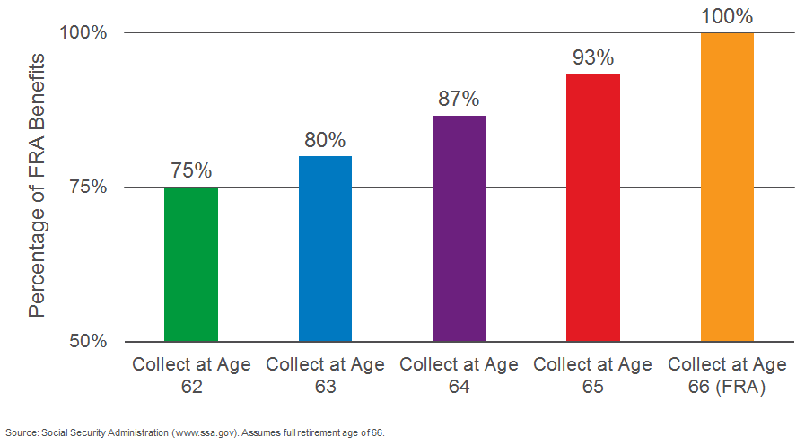
Cost of Collecting Benefits Early

Slide 30
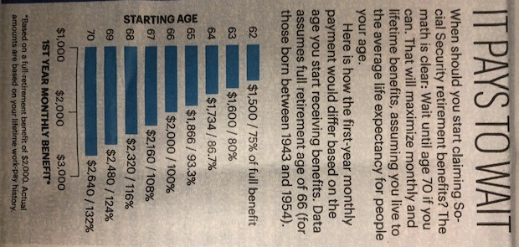
When to take Social Security
AARP Bulletin November 2018

Slide 31
How to Decide When to Receive Benefits
CONSIDERATIONS
TO THINK ABOUT
WORKING AND RECEIVING SOCIAL SECURITY
You may receive Social Security benefits at the same time you are employed
However, if you are below your full retirement age, $1 of benefits is deducted for every $3 earned above the annual limit (2018)
The annual limit on earnings is $17,040 in 2018.
HEALTH HISTORY
Consider your personal and family health history
If you’re in good health, postponing benefits will increase your benefits
If you are in poor health, you may want to choose to initiate benefits sooner
Social Security Administration: Retirement Planner: How We Deduct Earnings From Benefits, 2017
Notes:
As you’re thinking about when to start receiving Social Security benefits, here are a couple of things to consider.
If you wish to continue working, you may receive Social Security benefits while still employed. However, if you are below your Full Retirement Age, $1 of benefits is deducted for every $3 earned above the annual limit on earnings. In 2018, that annual limit is $17,040. If you wait until Full Retirement Age to begin collecting benefits, you can continue to work – or go back to work – without affecting your Social Security benefits.
You may also want to consider your personal and family health history:
If you’re in good health, postponing benefits will increase your benefits.
On the other hand, if you are in poor health, you may want to initiate benefits sooner.
When you decide to receive benefits will depend on your unique personal and financial circumstances. Your Financial Advisor can help you weigh the pros and cons of each option, and help you integrate Social Security into your overall retirement plan.

Slide 32
Social Security Benefits and Taxation
  You may be subject to income taxes if you have substantial income from other sources such as wages, self-employment, interest, dividends and other reportable taxable income in addition to 50% of your benefits.
    FILING AN INDIVIDUAL FEDERAL TAX RETURN
    A Single individual with a combined income between $25,000 and $34,000
      May have to pay federal income tax on 50% of his or her Social Security benefits
    A Single individual with a combined income in
    excess of $34,000
      May have to pay federal income tax on 85% of his or her Social Security benefits
    FILING A JOINT FEDERAL TAX RETURN
    A couple with a combined income between $32,000 and $44,000
      May have to pay federal income tax on 50% of their Social Security benefits
    A couple with a combined income in excess of $44,000
      May have to pay federal income tax on 85% of their Social Security benefits
Social Security Administration, Benefits Planner: Income Taxes And Your Social Security Benefits, 2017.
Notes:
Another thing to keep in mind is taxes.
You may be subject to income taxes on your Social Security benefits if you have substantial income from other sources, such as wages, self-employment, interest, dividends and other reportable taxable income.
If you are single and have a combined income between $25,000 and $34,000, you may have to pay federal income tax on 50% of your Social Security benefits. If your combined income is more than $34,000, up to 85 percent of your Social Security benefits may be taxable.
If you are a couple with a combined income between $32,000 and $44,000, you may have to pay federal income tax on 50% of your Social Security benefits. If your combined income is more than $44,000, up to 85 percent of your Social Security benefits may be taxable.

Slide 33
Benefits Beyond Retirement
SECTION 3
Notes:
Next, let’s talk about other benefits that Social Security offers which you may qualify for, depending on your situation.

Slide 34
Social Security Benefits for a Spouse, Survivor and
Divorced Spouse
Spousal Benefits
Survivor Benefits
Divorced Spouse Benefits
If you’re the working spouse, your nonworking spouse at full retirement age is eligible to receive the higher of 50% of your retirement benefit or 100% of his / her own benefit.
Survivor benefits are offered to widows and widowers at full retirement age, or a reduced survivor benefit is available as early as age 60.
You may qualify for a
divorced spouse’s benefits if you were previously married for 10+ years and divorced for at least two years.
Notes:
Social Security also offers spousal benefits, survivor benefits and even divorced spouse benefits.
First, spousal benefits. If you’re the working spouse, your nonworking spouse – at Full Retirement Age – is eligible to receive either 50% of your retirement benefit or 100% of his or her own retirement benefit, whichever is higher.
Social Security also offers survivor benefits for widows and widowers at Full Retirement Age. A reduced survivor benefit is available as early as age 60.
If you were previously married for at least 10 years and divorced for at least two years, you may qualify for divorced spouse benefits.

Slide 35
Family Maximum for Survivor Benefits
For Illustrative Purposes Only
Contact Social Security Administration at 1-800-772-1213 or visit www.ssa.gov

Slide 36
Maximize Benefits
Survivor Benefits
John FRA=66, PIA=$2,000, Life Expectancy:85 Claire FRA=66, Life Expectancy: 94
John Takes Claire’s lifetime
Social Security at Benefits
62 $355,200
66 $444,000
70 $465,120
Eligibility
Married to spouse for at least 9 months
Married to an ex-spouse for at least 10 years and did not remarry prior to age 60
Received the highest benefit if eligible for multiple survivor benefits
If eligible for own benefit and a survivor benefit, one may be activated early without reducing the other

Slide 37
John
PIA=$2,200
Jane
PIA= $600
Women Are Collecting
Their Husband’s benefits
John’s Benefits
63 and 6 mos.
$1,833
Survivor
Benefits
$1,833
John’s Benefits
(70)
$2,904
Survivor
Benefits
$2,904

Slide 38
Eligibility if Divorced
Divorced Benefits
  The ex-spouse may be entitled to 50% of an ex-spouse’s benefits if:
    Marriage lasted at least 10 years
    The couple has been divorced for at least 2 years
    The ex-spouse is currently unmarried
Divorced Survivor Benefits
  If client dies, ex-spouse may be eligible for benefits if:
    Ex-spouse was collecting Social Security or disability insurance at time of death
    Marriage lasted at least 10 years
    Ex-spouse has not remarried prior to age 60

Slide 39
Disability Benefits
You are eligible if:
Your disability prevents you from performing any substantial gainful work
AND
Your disability is expected to last for at least 12 months or the rest of your life
When you reach Full Retirement Age, disability benefits cease and your normal retirement benefits begin.
Notes:
Social Security offers far more than retirement benefits for you. It also provides disability benefits, though these benefits are not as generous as those typically available from a privately-owned disability policy.
You are eligible for the Social Security disability benefit if your disability prevents you from performing any substantial gainful work and if your disability is expected to last for at least twelve months or for the rest of your life.
Disability benefits cease when you reach Full Retirement Age. At that time, your normal retirement benefits kick in.

Slide 40
Planning Your Retirement Strategy
SECTION 4
Notes:
Finally, let’s take a moment to talk about how to get started on planning for retirement with Social Security in mind.

Slide 41
Start Planning Now
Accumulating Assets
Converting assets to income
Managing Investment Risk
Managing new risks – longevity, inflation, unforeseen expenses
Earning Income at Work
Making the most of what you have
Notes:
Even though you may not reach your Full Retirement Age or even age 62 for a number of years, you should start thinking about your strategy now.
You’ve been accumulating assets for retirement over your entire career. But, now, the paradigm is shifting. You should start thinking about converting what you have to income – enough income to meet day-to-day needs and unforeseen expenses for the rest of your life.
You should also start thinking about managing risk, not just managing your investments. That means managing the risk of outliving your assets, of seeing your buying power eroded by inflation, of being able to afford medical expenses or possibly long-term care for you and your spouse.
And finally, you have to start thinking about making the most of what you have. And that means not only your assets, but any pension you might have and, of course, Social Security.

Slide 42
Filling the Income Gap
Essential expenses such as health care and mortgages should be covered by “guaranteed” income sources:
Social Security
Annuities
Pensions

Slide 43
Setting Goals According to Your Needs
As your life stage changes, so do your goals – our platform allows you to look across you assets and liabilities to help you adapt your strategy to meet those changing demands
LIFESTYLE
CHOICES
LENGTH OF
RETIREMENT
EDUCATION
CAREER
PATH
FAMILY
DYNAMICS
PURCHASE
DECISIONS
LEGACY
PLAN
Early / Mid-Career
Goals
Buy a home
Have a child
Build an emergency fund
Protect family
Late Career
Goals
Buy a larger home
Send children to college
Assist aging parents
Plan for future health care
Plan for retirement
Retired
Goals
Maintain lifestyle and
sufficient income
Meet health care and other unforeseen expenses
Buy a vacation home
Legacy planning
GOALS
ASSETS
LIABILITIES
Notes:
At Morgan Stanley, we have developed a new way of thinking about wealth management, a methodology that we believe will give you a more accurate picture of where you are in relation to your most important goals, how far you have to go and what you have to do to get there. We call this Goals-Based Wealth Management.
As your life stage changes, so do your goals.
Early on in your career, your goals may have been buying a home, starting a family and building an emergency fund. Later, your priorities may have shifted to sending your children to college, assisting aging parents and planning for retirement. In retirement, your focus may be on maintaining your lifestyle, meeting health care expenses and creating your legacy.
Our platform allows you to look across your assets and liabilities to help you adapt your wealth management strategy to meet those changing demands.

Slide 44
Your Financial Advisory Team at Morgan Stanley
Our Financial Advisors Can Provide:
Answers to your questions about Social Security and retirement
Access to the global resources of Morgan Stanley
Financial solutions that address your specific needs and goals
Kit Mac Nee, CFP®, CRPC®
Financial Advisor
626-405-9303(0ffice) 626-317-8215(cell)
Mary.Mac.Nee@morganstanley.com
Notes:
I hope you’ll take the time to meet with me individually and discuss your retirement goals and how we can help you reach them. The time to start is now. And just the fact that you’re here today is a great beginning.
Thank you for coming. It was a pleasure being here with you today.
May I answer any questions?

Slide 45
Disclosures
Tax laws are complex and subject to change. Morgan Stanley Smith Barney LLC (“Morgan Stanley”), its affiliates and Morgan Stanley Financial Advisors and Private Wealth Advisors do not provide tax or legal advice and are not “fiduciaries” (under ERISA, the Internal Revenue Code or otherwise) with respect to the services or activities described herein except as otherwise provided in writing by Morgan Stanley and/or as described at www.morganstanley.com/disclosures/dol . Individuals are encouraged to consult their tax and legal advisors (a) before establishing a retirement plan or account, and (b) regarding any potential tax, ERISA and related consequences of any investments made under such plan or account.
Morgan Stanley Smith Barney LLC is a registered Broker/Dealer, Member SIPC, and not a bank. Where appropriate, Morgan Stanley Smith Barney LLC has entered into arrangements with banks and other third parties to assist in offering certain banking related products and services.
Investment, insurance and annuity products offered through Morgan Stanley Smith Barney LLC are: NOT FDIC INSURED | MAY LOSE VALUE | NOT BANK GUARANTEED | NOT A BANK DEPOSIT | NOT INSURED BY ANY FEDERAL GOVERNMENT AGENCY
Residential mortgage loans/home equity lines of credit are offered by Morgan Stanley Private Bank, National Association, an affiliate of Morgan Stanley Smith Barney LLC. With the exception of the pledged-asset feature, an investment relationship with Morgan Stanley Smith Barney LLC does not have to be established or maintained to obtain the residential mortgage products offered by Morgan Stanley Private Bank, National Association. All residential mortgage loans/home equity lines of credit are subject to the underwriting standards and independent approval of Morgan Stanley Private Bank, National Association. Rates, terms, and programs are subject to change without notice. Residential mortgage loans/home equity lines of credit may not be available in all states; not available in Guam, Puerto Rico and the U.S. Virgin Islands. Other restrictions may apply. The information contained herein should not be construed as a commitment to lend. Morgan Stanley Private Bank, National Association is an Equal Housing Lender and Member FDIC that is primarily regulated by the Office of the Comptroller of the Currency. Nationwide Mortgage Licensing System Unique Identifier #663185. The proceeds from a residential mortgage loan (including draws and advances from a home equity line of credit) are not permitted to be used to purchase, trade, or carry eligible margin stock; repay margin debt that was used to purchase, trade, or carry margin stock; or to make payments on any amounts owed under the note, loan agreement, or loan security agreement; and cannot be deposited into a Morgan Stanley Smith Barney LLC or other brokerage account.
Tailored Lending is a loan/line of credit product offered by Morgan Stanley Private Bank, National Association, an affiliate of Morgan Stanley Smith Barney LLC. A Tailored Lending credit facility may be a committed or demand loan/line of credit. All Tailored Lending loans/lines of credit are subject to the underwriting standards and independent approval of Morgan Stanley Private Bank, National Association. Tailored Lending loans/lines of credit may not be available in all locations. Rates, terms, and programs are subject to change without notice. Other restrictions may apply. The information contained herein should not be construed as a commitment to lend. Morgan Stanley Private Bank, National Association is a Member FDIC that is primarily regulated by the Office of the Comptroller of the Currency. The proceeds from a Tailored Lending loan/line of credit (including draws and other advances) may not be used to purchase, trade, or carry margin stock; repay margin debt that was used to purchase, trade, or carry margin stock; and cannot be deposited into a Morgan Stanley Smith Barney LLC or other brokerage account.
Securities based loans are provided by Morgan Stanley Smith Barney LLC, Morgan Stanley Private Bank, National Association or Morgan Stanley Bank, N.A, as applicable.
Important Risk Information for Securities Based Lending: You need to understand that: (1) Sufficient collateral must be maintained to support your loan(s) and to take future advances; (2) You may have to deposit additional cash or eligible securities on short notice; (3) Some or all of your securities may be sold without prior notice in order to maintain account equity at required maintenance levels. You will not be entitled to choose the securities that will be sold. These actions may interrupt your long-term investment strategy and may result in adverse tax consequences or in additional fees being assessed; (4) Morgan Stanley Bank, N.A., Morgan Stanley Private Bank, National Association or Morgan Stanley Smith Barney LLC (collectively referred to as “Morgan Stanley”) reserves the right not to fund any advance request due to insufficient collateral or for any other reason except for any portion of a securities based loan that is identified as a committed facility; (5) Morgan Stanley reserves the right to increase your collateral maintenance requirements at any time without notice; and (6) Morgan Stanley reserves the right to call securities based loans at any time and for any reason.

Slide 46
Disclosures (Cont’d)
The Morgan Stanley Credit Card from American Express or the Platinum Card® from American Express exclusively for Morgan Stanley is only available for clients who have an eligible Morgan Stanley Smith Barney LLC brokerage account (“eligible account”). Eligible account means a Morgan Stanley Smith Barney LLC brokerage account held in your name or in the name of a revocable trust where the client is the grantor and trustee, except for the following accounts: Charitable Remainder Annuity Trusts, Charitable Remainder Unitrusts, irrevocable trusts and employer-sponsored accounts. Eligibility is subject to change. American Express may cancel your Card Account and participation in this program, if you do not maintain an eligible account. Morgan Stanley Smith Barney LLC may compensate your Financial Advisor and other employees in connection with your acquisition or use of either the Morgan Stanley Credit Card from American Express or the Platinum Card® from American Express exclusively for Morgan Stanley.
The Morgan Stanley Cards from American Express are issued by American Express Bank, FSB, not Morgan Stanley Smith Barney LLC. Services and rewards for the Cards are provided by Morgan Stanley Smith Barney LLC, American Express or other third parties. Restrictions and other limitations apply. See the terms and conditions for the Cards for details. Clients are urged to review fully before applying.
The lending products referenced are separate and distinct, and are not connected in any way. The ability to qualify for one product is not connected to an individual’s eligibility for another.
The Morgan Stanley Debit Card is currently issued by UMB Bank, N.A., pursuant to a license from MasterCard International Incorporated. MasterCard and Maestro are registered trademarks of MasterCard International Incorporated. The third-party trademarks and service marks contained herein are the property of their respective owners.
Reserved clients are eligible for unlimited ATM fee rebates and Non-Reserved clients are eligible for up to $200 in ATM fee rebates per calendar year. The $200 per calendar year cap does not apply to Premier Cash Management Accounts.
The Morgan Stanley Mobile App is currently available for iPhone® and iPad® from the App StoreSM and AndroidTM on Google PlayTM. Standard messaging and data rates from your provider may apply.
Premier Cash Management is an incentive program that recognizes and rewards clients for choosing Morgan Stanley for their everyday cash management needs. Clients must meet certain criteria in order to qualify for the Premier Cash Management program, and Morgan Stanley Smith Barney LLC reserves the right to change or terminate the program at any time and without notice. Where appropriate, Morgan Stanley Smith Barney LLC has entered into arrangements with affiliated and non-affiliated parties to assist in offering certain products and services related to Premier Cash Management. Please refer to the Premier Cash Management Terms and Conditions for further details.
Send Money with Zelle is available on the Morgan Stanley Mobile App for iPhone and Android. Enrollment is required and dollar and frequency limits may apply. Domestic fund transfers must be made from an eligible account at Morgan Stanley Smith Barney LLC (Morgan Stanley) to a US-based account at another financial institution. Morgan Stanley maintains arrangements with JP Morgan Chase Bank, N.A. and UMB Bank, N.A. as NACHA-participating depository financial institutions for the processing of transfers on Zelle. Data connection required, and message and data rates may apply, including those from your communications service provider. See the Morgan Stanley Send Money with Zelle terms for details. Zelle and the Zelle related marks are wholly owned by Early Warning Services, LLC and are used herein under license. Morgan Stanley is not affiliated with Zelle. Zelle is available to U.S. bank account holders only. Transactions typically occur within minutes.
To understand the differences between brokerage and advisory relationships, you should consult your Financial Advisor, or review our Understanding Your Brokerage and Investment Advisory Relationships brochure available at http://www.morganstanley.com/ourcommitment/
Insurance products are offered in conjunction with Morgan Stanley Smith Barney LLC’s licensed insurance agency affiliates.
Morgan Stanley Smith Barney LLC does not accept appointments nor will it act as a trustee but it will provide access to trust services through an appropriate third-party corporate trustee.
Although they may be admitted attorneys, planning directors and other wealth planning center personnel holding legal degrees are acting purely in a non-representative capacity. Neither they nor Morgan Stanley provide tax or legal advice to clients or to Morgan Stanley.
The Morgan Stanley Global Impact Funding Trust, Inc. (“MS GIFT, Inc.”) is an organization described in Section 501(c) (3) of the Internal Revenue Code of 1986, as amended. MS Global Impact Funding Trust (“MS GIFT”) is a donor-advised fund. Morgan Stanley Smith Barney LLC provides investment management and administrative services to MS GIFT.

