Slide 1
Medicare ABCs 2020 www.maximizeyourmedicare.com

Slide 2
About Me
Certified Financial Planner™
Chartered Life Underwriter (CLU®)
Chartered Financial Consultant (ChFC®)
Quoted in National Press (USA Today, cnbc, Dow Jones)
Managing Principal, GH2 Benefits, LLC
M.B.A., in Accounting and Finance from the University of Chicago
B. A. in Economics and Political Science from the University of Michigan, Ann Arbor.
> 10 years in Global financial centers
Author of top-rated, top-selling Maximize Your Medicare: Understanding Medicare, Protecting Your Health, and Minimizing Costs

Slide 3
Important Disclaimers
Information session only: not financial advice
Not an offer of any financial product or contract, including insurance, Medicare Advantage, Medicare Part D or Medicare Advantage plans
Not affiliated/endorsed by the Department of Health and Human Services
Regulated by State of Michigan and CFP Board of Professional Standards
While every effort has been made to ensure that the information in this session is accurate, there may be errors or omissions. You should verify all information in this session.

Slide 4
Outline
Where We Are Going
Eligibility & Enrollment
Part A (Hospital) & Part B (Health)
Part D (Prescriptions)
Medicare Advantage
Medigap
Common Mistakes / Q&A

Slide 5
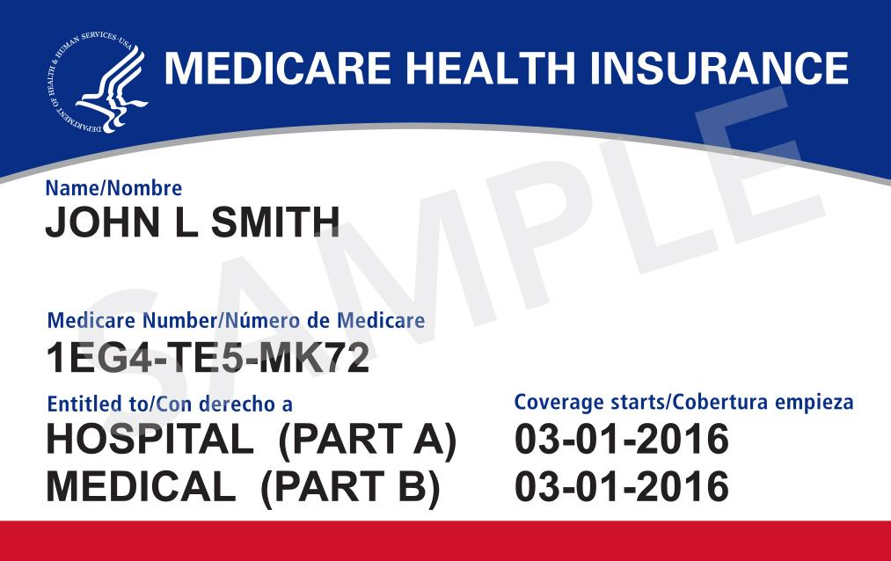
Eligibility & Enrollment

Slide 6
Eligibility Guidelines
Exceptions
When you turn 65
Medicare runs off the 1st day of the month, not your actual date of birth
End-Stage Renal Disease w Dialysis
ALS (Lou Gehrig’s Disease)
Social Security Disability Insurance
Born on the 1st of the month

Slide 7
Enrollment Beyond 65
Part B enrollment deadline is technically 8 months after retirement
“Can do” is very different from “should do”
Complicated, and getting more difficult as people work beyond 65

Slide 8
Late Enrollment Penalties
Part A exists (very rare): 10%, for 2x as long as you have not correctly enrolled.
Part B: 20% x Part B premium x years, never expires, recalculated annually.
Part D: 1% x #months x national average, never expires, recalculated annually.

Slide 9
Enrollment Bottom Lines
Delaying = asking for problems, and tempting luck
Remember: there are additional steps to take and you/we do not control the timing of execution

Slide 10
Part A: Facilities

Slide 11
Part A: The Good, The Costly
Hospital Inpatient stay | First 60 Days Cost: You pay $0. Days 61-100: You pay the first $352.00 a day. Medicare pays the rest. Days 101–150: You pay the first $704.00 a day. Medicare pays the rest. Days 150 +: You pay 100% | Deductible: $1,408.00 per benefit period (See Glossary for definition of benefit period)
Skilled Nursing Facility Care Stay | First 20 Days Cost: Medicare pays 100% Days 21-100: You pay the first $176.00 a day; Medicare pays for the remainder. Days 101+: You pay 100% | ONLY after a 3-day inpatient stay at a hospital Skilled Nursing Care is a technical term and does not include solely custodial care.
Inpatient Psychiatric Care | 190 days lifetime benefit, Medicare pays 100% You pay $0.

Slide 12
Part A: The Fine Print
Benefit Period
Deductible = $1,408 per Benefit Period
Benefit Period = “Medical Event”
Observation Status
Part A Depends on Inpatient Status
Observation Status Not Covered by Medicare Part A
Two-midnight rule now in effect
Skilled Nursing Facility (SNF)
Still Requires 3-day Inpatient Status
Improvement Status waived: a huge positive

Slide 13
Part B: Services

Slide 14
Part B: Different Setup
Monthly Premium, “unchanged”
Annual Deductible = $185.00 per year, reset annually
Coinsurance: Medicare pays 80%, you pay 20%
Approved Amount
IRMAA-Adjusted Premiums (2020)
Individual | Joint | Monthly Premium
$85,000 or less | $170,000 or less | $135.50
$85,000 – $107,000 | $170,000 – $214,000 | $189.60
$107,000 – $133,500 | $214,000 -$267,000 | $270.90
$133,500 – $160,000 | $267,000 – $320,000 | $352.20
$160,000 – $500,000 | $320,000 – $750,000 | $433.40
Greater than $500,000 | Greater than $750,000 | $460.50
Individual | Joint | Monthly Premium
$87,000 or less | $174,000 or less | $144.60
$87,000 – $109,000 | $174,000 – $218,000 | $202.40
$109,000 – $136,000 | $218,000 -$272,000 | $289.20
$136,000 – $163,000 | $272,000 – $326,000 | $376.00
$163,000 – $500,000 | $326,000 – $750,000 | $462.70
Greater than $500,000 | Greater than $750,000 | $491.60

Slide 15
Part B: The Fine Print
Part B Excess Charge
Medicare has a long list of treatments
Willing to pay $X for a particular treatment (“approved charge”)
Actual charge – approved charge = Part B Excess
Part B Excess can be 15% higher than approved charge
Likely?
Certain states have laws that disallow this (MOM Law)
Physicians = $120,000 debt
Medicare payments declining (sequester, Obamacare, CMS)
You can ask providers in advance

Slide 16
Part D: Rx
Annual contract means that everything subject to change
Complicated combination
Premiums
Copays
Formulary
IRMAA-Adjusted Premiums (2020)
Individual | Joint | Monthly Premium
$87,000 or less | $174,000 or less | Plan Premium
$87,000 – $109,000 | $174,000 – $218,000 | $12.40 + Plan Premium
$109,000 – $136,000 | $218,000 -$272,000 | $31.90 + Plan Premium
$136,000 – $163,000 | $272,000 – $326,000 | $51.40 + Plan Premium
$163,000 – $500,000 | $326,000 – $750,000 | $70.90 + Plan Premium
Greater than $500,000 | Greater than $750,000 | $77.40 + Plan Premium

Slide 17
Part D: Coverage Gap (2020)
Annual Prescription Costs
$0-$435: May/may not be covered in Part D
$435-$4,020: Copay according to schedule
$4,020-$6,350: 75% discount, you pay 25%
> $6,350: You pay greater of 5% or $3.60/$8.95 (!!!!)
Consumer Hint: Check every year. Premiums, copays, formulary will change on an annual basis
Number of Plans has increased per state: 29 in MI

Slide 18
Original Medicare Summary
Summary
Part A: No premium, high out-of-pocket expenses
Part B: Monthly premium, deductibles, and coinsurance
Problem: No annual limit on out-of-pocket expenses
Bottom line: Original Medicare is risky
Two Choices
Medicare Advantage (aka Medicare Part C)
Medigap (aka Medicare Supplemental)

Slide 19
Medigap Basics
Plans A-N
Higher premiums, superior cost-sharing
Prices usually change with age
January 2020: Plan C & F will no longer be available to new applicants
Medicare Part A deductibles largely covered
Medicare Part B copays covered
Medicare Part B Excess charge covered by F&G
Standardized means coverage same across carriers
Grandfathered means the terms don’t change. In an uncertain world, these are very valuable

Slide 20
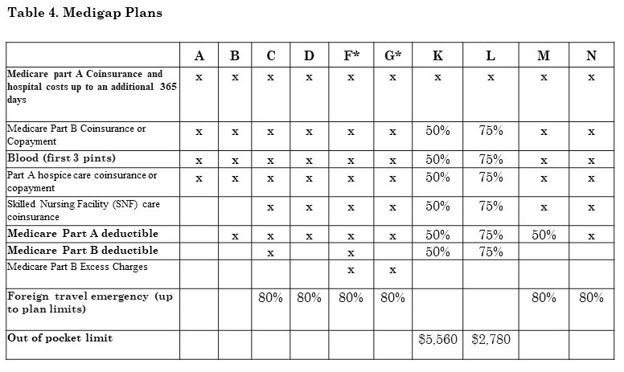
Standardized Medigap Plans

Slide 21
Medigap Entry Getting Harder
Perfect Health?
Yes, accepted
Sellers in Control after you turn 65.5
Unless you are Guaranteed Issue (there are MANY situations where this IS the case)
Knowing Exceptions is GH2 Benefits’ Job
Imperfect Health?
The Seller is in Control After Medigap Open Enrollment and Guaranteed Issue Rights Expire
Acceptance is getting more difficult as price competition becomes more fierce
Mid-MI: 65 yr old female >> 5 sellers within $10/month

Slide 22
Medicare Advantage Basics
Also Known as Medicare Part C
Approved Annually by the CMS
Everything handled by private company
Must be at least as good as original Medicare…on average
Combines Part A, Part B, & Part D (mostly)
Annual Contract
Separate cost-sharing
Network
Cost vs Moving Target
In certain cases, no additional premium
Annual contract means that it changes every year

Slide 23
Future of Medicare Advantage
Medicare Advantage is Expanding Rapidly
Currently > 30% market share
CEOs of health insurance carriers predict 50%
New carriers are ENTERING, not exiting
Mergers occurring nationwide
Sellers are Not Gamblers
2% - 5% Profit Margin
Superiority of Medigap is Declining
MAPD: Health deductible declining
MAPD: Open networks
Added benefits will be included in 2020

Slide 24
When You Can Change
Annual Election Period (AEP)
October 15 – December
Medicare Advantage and PDP
Can make unlimited changes
Open Enrollment Period (OEP)
January 1 – March 31
Medicare Advantage and PDP
Can make ONE change
ALSO: If you have missed original Medicare enrollment, NOW is the chance to enroll in Part A and Part B
Exceptions
Extra Help: 1x per quarter and AEP
Lose Medicaid or Extra Help
Five-Star: anytime during year into a Five-Star plan

Slide 25
Medicare & Medicaid
EVERY COUNTY in lower peninsula Examples of additional benefits:
Transportation
Dental & vision
Care coordinator to help you manage Rx
OTC vouchers

Slide 26
Common Medicare Mistakes
Mistake #1: Late Preparation
People give away free options to enroll in Medigap
People are unintentionally assessed IRMAA
People don’t understand that Part A is backdated when you begin receiving Social Security benefits
COBRA can only really be used for 7 months
Mistake #2: Set It and Forget It
Doesn’t make practical sense: competition fierce
Prescription drug costs can vary > $1000 / year
Medicare Advantage mergers
Medigap has competition

Slide 27
Common Medicare Mistakes
Mistake #3: Blindly Believing in Employer Benefits
People working beyond 65 stay on employer-provided plans: why?
Employer-provided plans: high premiums & cost-sharing
Spouse or dependents? Check the ACA (and the APTC)
Employees at small-employers should check with the employer
Mistake #4: Blindly Believing In Retiree Benefits
Doesn’t make practical sense: competition fierce
Prescription drug costs can vary > $1000 / year
Medicare Advantage mergers
Medigap has competition
Even the Sacred Cows are endangered

Slide 28
Medicare is Step #1A
More Important than Social Security
Many options now restricted
Outcomes Affect Finances & Your Healthcare Providers
Investments / Financial Products
Annuities
Long-Term Care
Medicare’s language is regulated and standardized
Other financial contracts are not
Language More Complicated
Written by Rooms of “Me”
Complicated Calculations, Written by “Me”
Not standardized, at all

Slide 30
Facebook Community

Slide 31
www.gh2benefits.com
Nationwide
Free Initial Consultation
By Appointment Only
(855) 463 - 9688

