Slide 1


Best Practices for Retirement Income Planning
Wade Pfau, Ph.D., CFA
www.RetirementResearcher.com

Slide 2
AGENDA
RETIREMENT:
Is It Really Different?
RETIREMENT RISKS
STRATEGIES FOR SUCCESS
Theory Behind the 4% Rule
Two Schools of Thought on Retirement
Risk Pooling vs. Risk Premium
Product Allocation with Investments and Insurance

Slide 3

“Professor Mandell, editor of Financial Services Review, invited me to contribute an article related to financial research for the individual for the first issue of this journal. Since the subject is not my specialty, it was uncharacteristically risky of me to have accepted the invitation. But an evening of reflection convinced me that there were clear differences in the central features of investment for institutions and investment for individuals, that these differences suggest differences in desirable research methodology, and that a note on these differences may be of value.”
Retirement
Requires a
Different
Approach
Financial Services Review, 1991

Slide 4

What’s Different About Retirement?
Reduced earnings capacity
Visible spending constraint
Heightened investment risk
Unknown longevity
Spending shocks
Compounding inflation
Declining cognitive abilities

Slide 5

Pre-Retirement vs.
Retirement

Slide 6
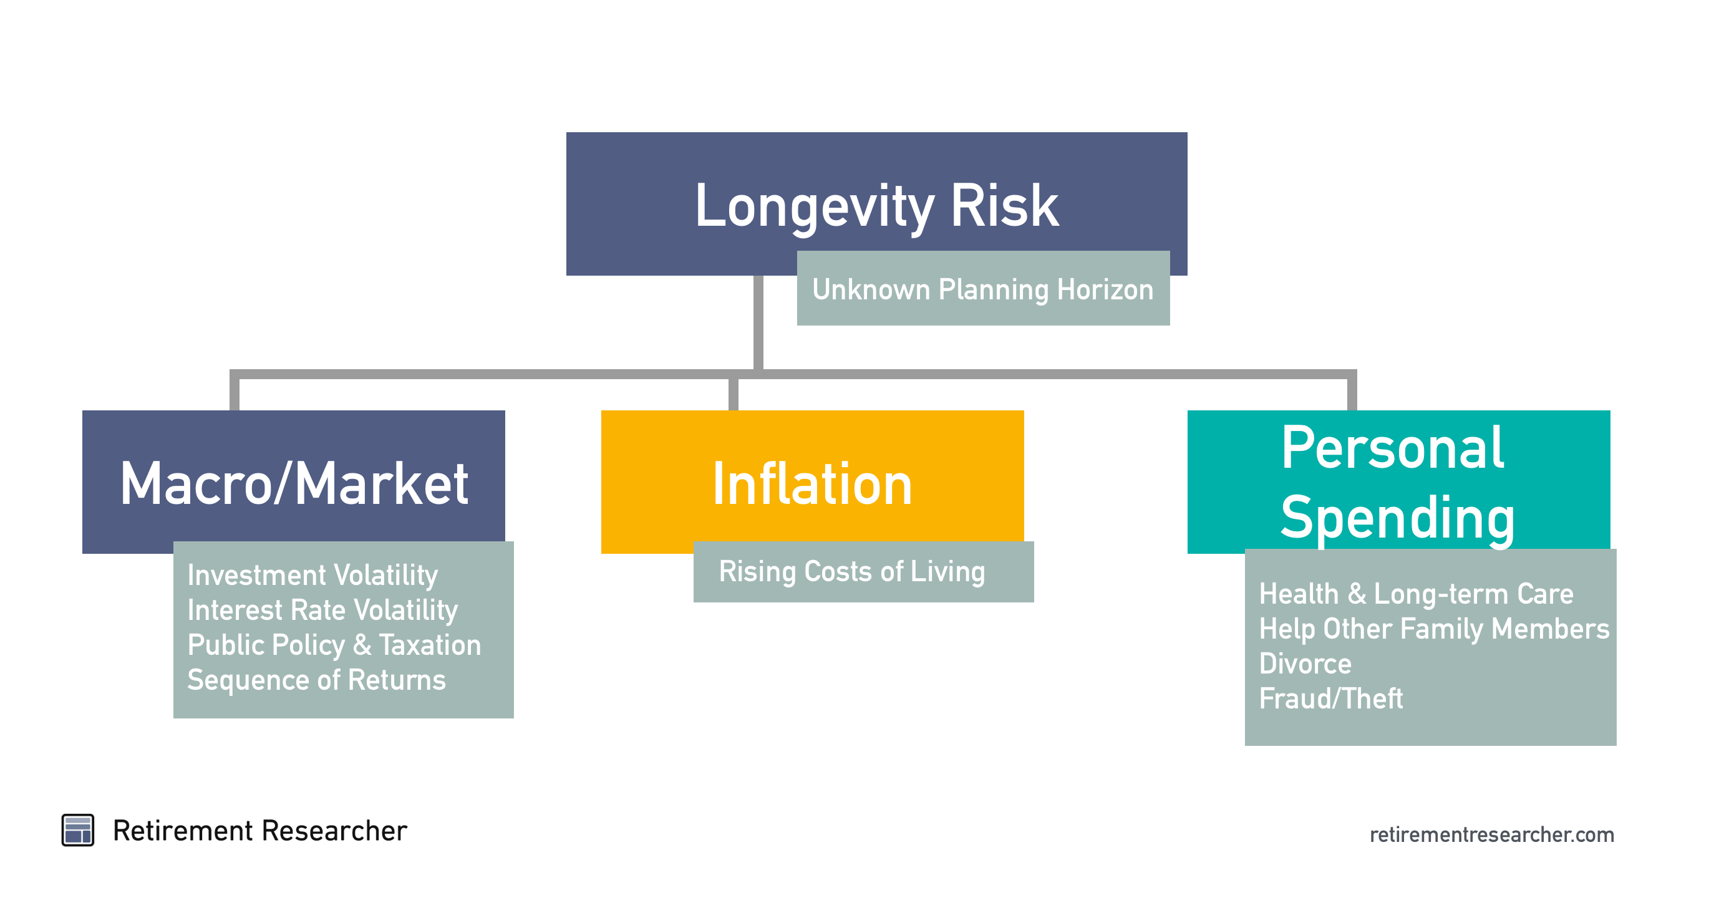
Key Retirement Risks
Notes:
Where things are ultimately heading
Currently, not account for maintain control, health problems, etc.
Not all tools

Slide 7
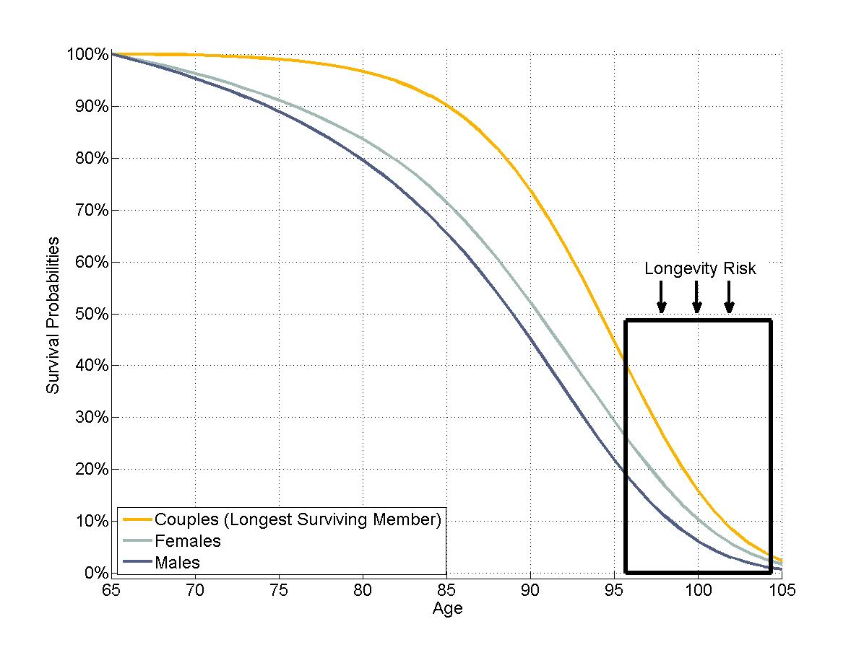
Longevity Risk
Source: Society of Actuaries, 2012 Individual Annuity Mortality tables, with projections for 2016

Slide 8
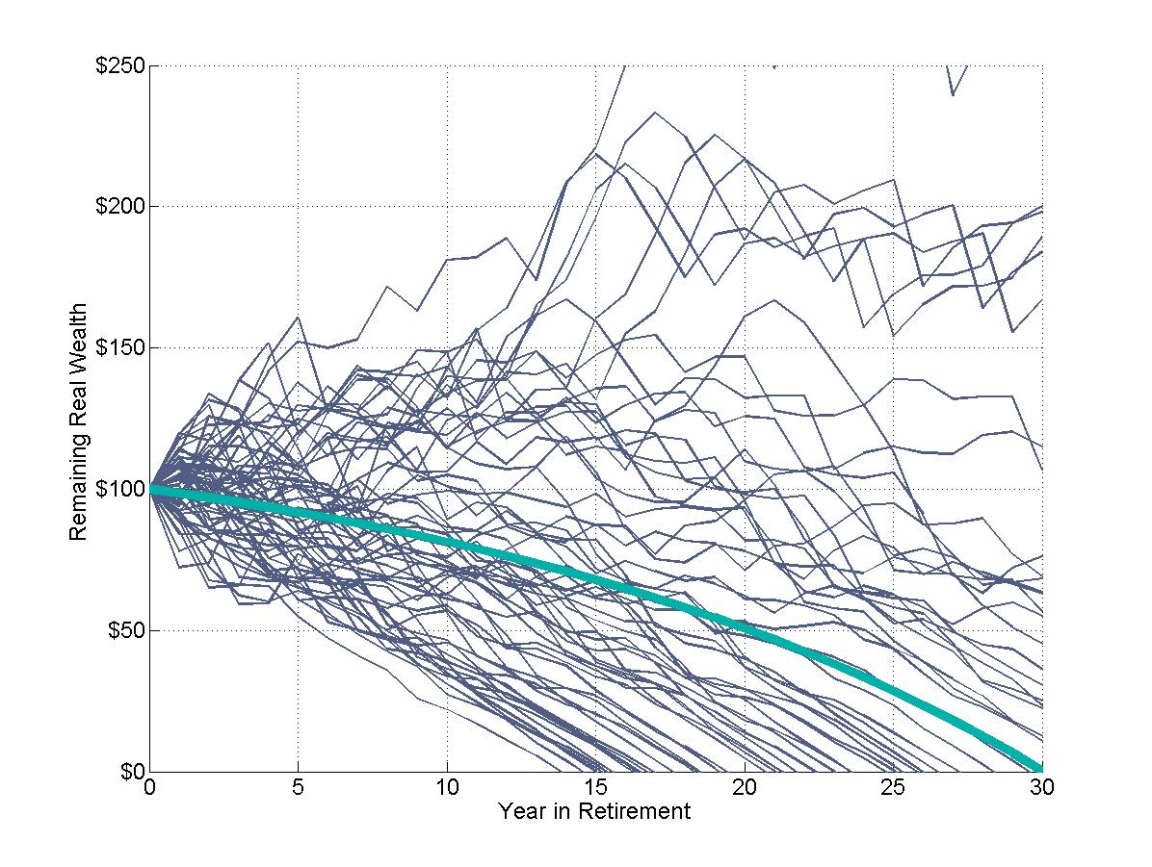
Market Risk: Fixed vs. Random Returns
Wealth Glidepath Over
a 30-Year Retirement
For a 6.3% Initial Withdrawal Rate, 50/50 Asset Allocation,
Inflation Adjustments
Using SBBI Data, 1926-2016,
S&P 500 and Intermediate Term Government Bonds

Slide 9
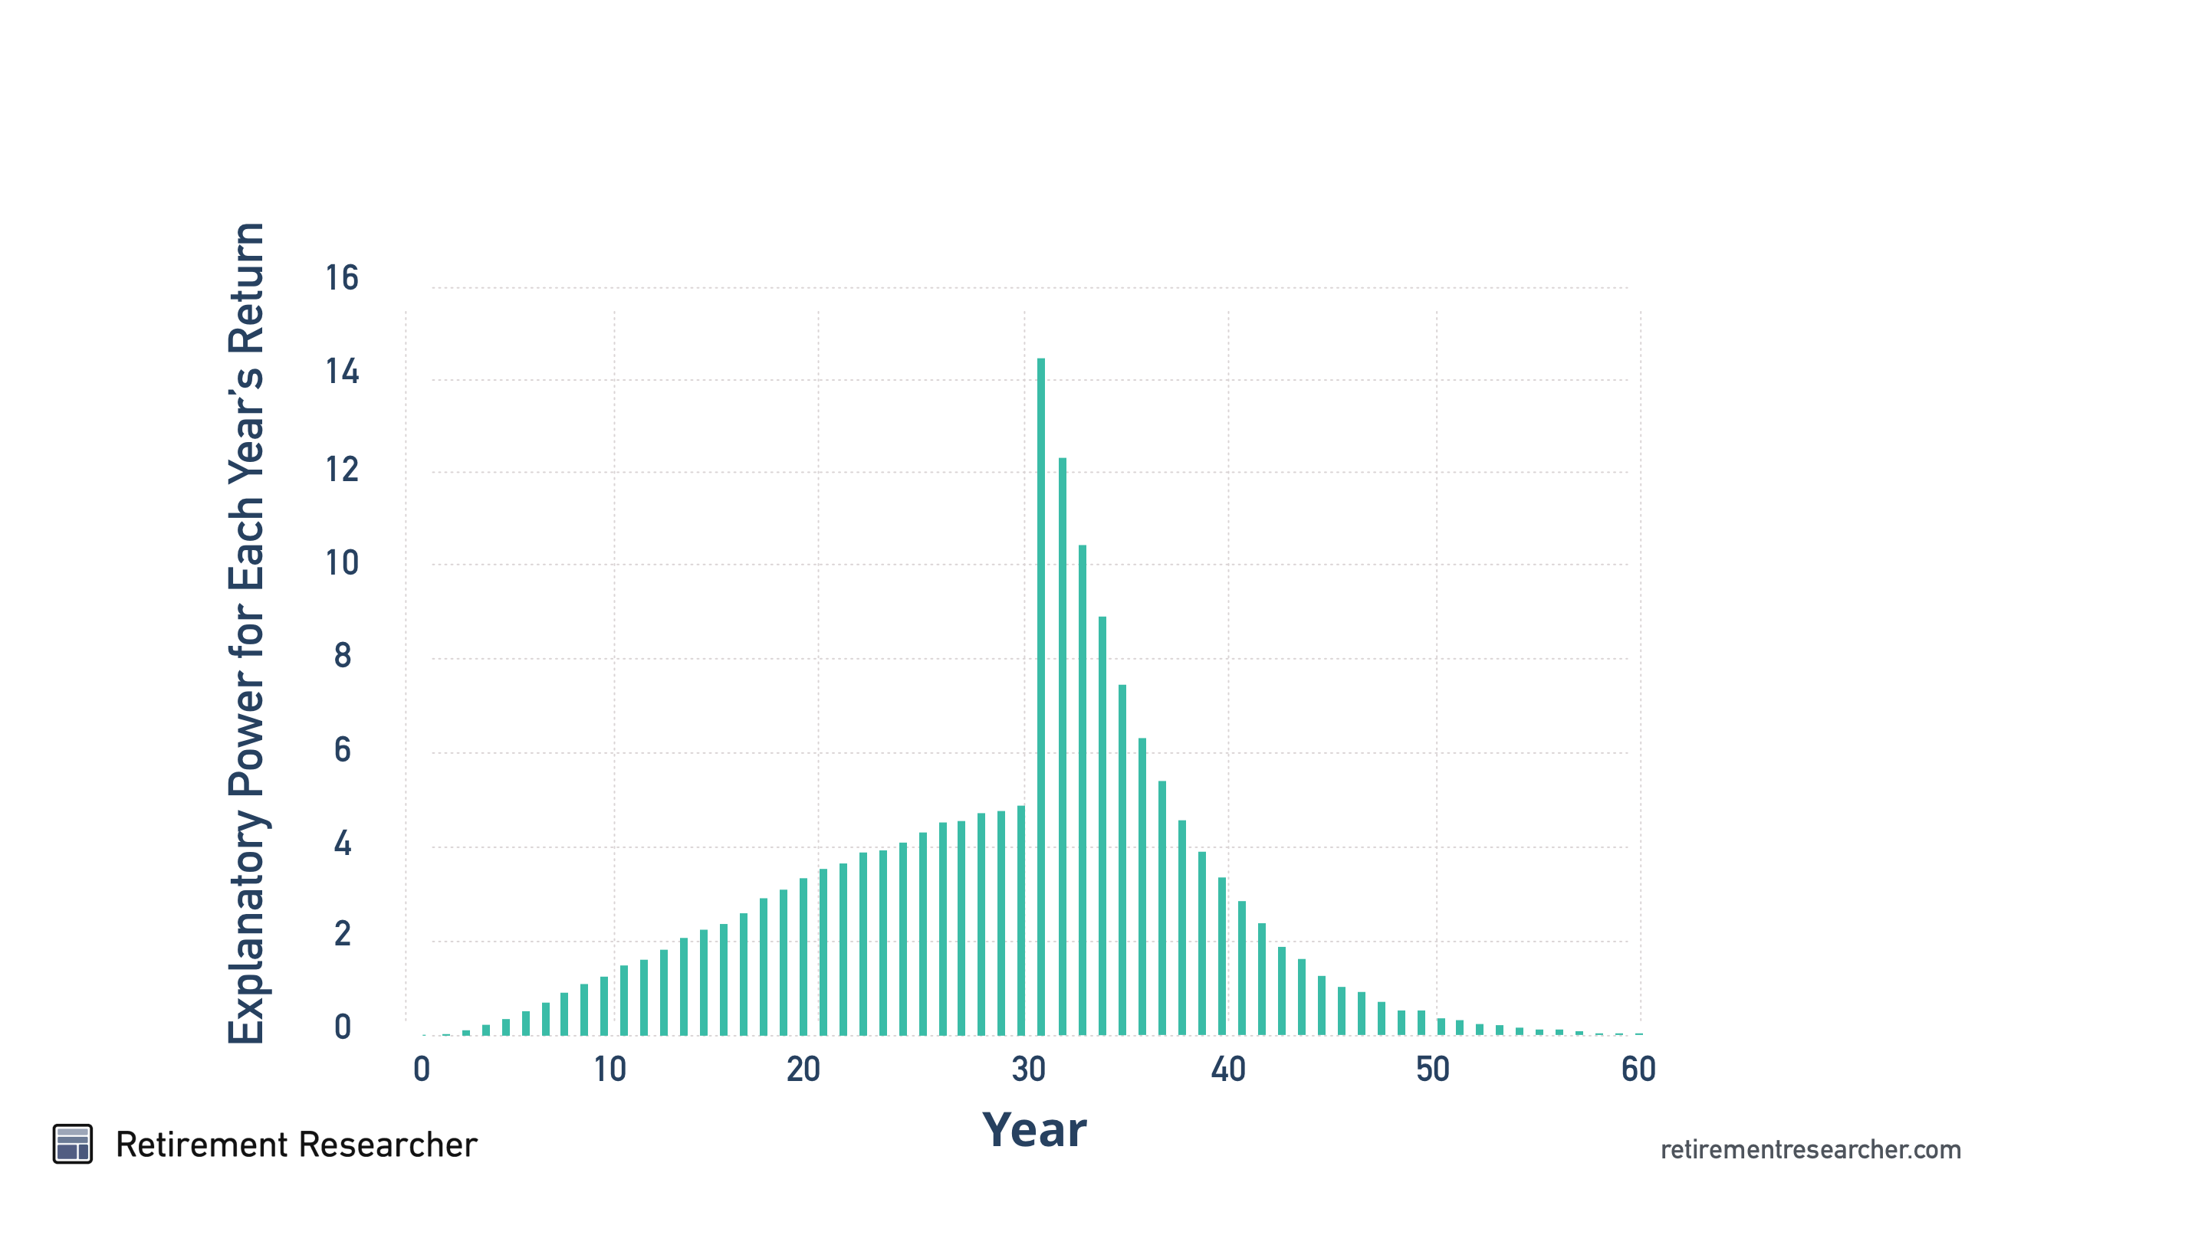
Lifetime Sequence of Returns Risk

Slide 10
Managing Sequence Risk
Spend Conservatively
Spending Flexibility
Reduce Volatility
  Build a lifetime spending floor with annuities
Buffer Assets – Avoid Selling at Losses

Slide 11
Challenges for an Individual Pension Plan
Asset Returns
  Pension Managers – Pool returns across generations
  Households – One whack at the cat
  Longevity Risk
  Pension Managers – systemic increases in longevity
  Households – Idiosyncratic longevity risk

Slide 12
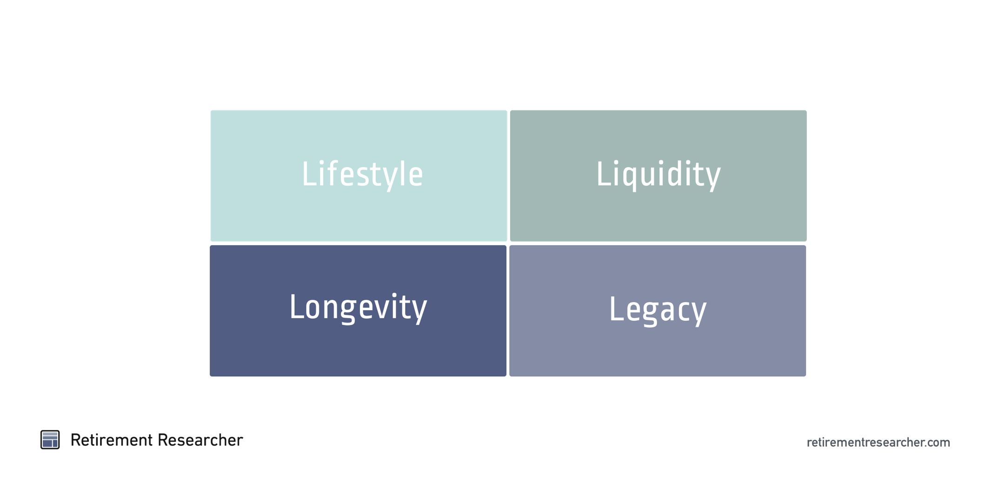
Retirement Goals

Slide 13
Retirement Income Philosophies
Probability-Based Safety-First
Prioritization Among Goals | Focus on overall lifestyle spending goals | Distinguish retirement spending goals between essential needs and discretionary expenses
Investment Approach | Focus on a total returns investing for the entire financial portfolio to maximize returns for an acceptable level of volatility | Match assets to different goals so that risk levels are compatible. Allows a wider role for holding individual bonds and using income annuities.
Measuring Retirement Success | Focus on determining an acceptable probability of failure for the overall retirement plan | Seeks to minimize harms in worst-case scenarios by avoiding failure for essential needs
Safe Withdrawal Rate | The historical record suggests that 4% or 4.5% is about as bad as it gets | Unknown and unknowable. Risky assets are inherently risky and the historical success of a strategy does not provide sufficient confidence

Slide 14
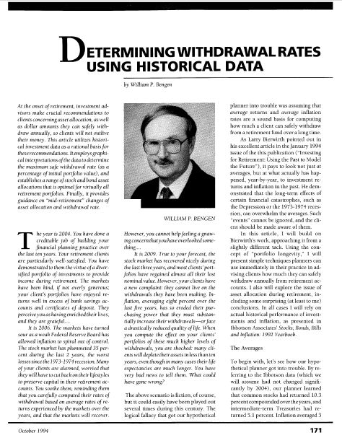
Safe
Withdrawal
Rates and
The 4% Rule
William Bengen
Journal of Financial Planning, October 1994

Slide 15
Relationship between Interest Rates,
Planning Horizon, and Sustainable Spending for a 65-year old with $1 million
 |  | Fixed Return
 |  | 0% | 0.5% | 1.5% | 2.5% | 3.5% | 4.5% | 5.5%
Planning Horizon (Age) | 70 | $200,000 | $202,000 | $205,999 | $209,997 | $213,992 | $217,982 | $221,968
 | 75 | $100,000 | $102,259 | $106,832 | $111,472 | $116,175 | $120,937 | $125,751
 | 80 | $66,667 | $69,019 | $73,837 | $78,797 | $83,889 | $89,104 | $94,432
 | 85 | $50,000 | $52,404 | $57,385 | $62,583 | $67,982 | $73,566 | $79,317
 | 90 | $40,000 | $42,440 | $47,550 | $52,952 | $58,622 | $64,535 | $70,663
 | 95 | $33,333 | $35,800 | $41,024 | $46,612 | $52,533 | $58,748 | $65,218
 | 100 | $28,571 | $31,060 | $36,388 | $42,152 | $48,308 | $54,804 | $61,588
 | 105 | $25,000 | $27,508 | $32,933 | $38,865 | $45,244 | $52,003 | $59,071
 | 110 | $22,222 | $24,747 | $30,266 | $36,359 | $42,950 | $49,954 | $57,281

Slide 16
Relationship between Interest Rates,
Planning Horizon, and Sustainable Spending for a 65-year old with $1 million
4% Rule:
30-year time horizon
Real fixed compounded return: 1.3%
 |  | Fixed Return
 |  | 0% | 0.5% | 1.5% | 2.5% | 3.5% | 4.5% | 5.5%
Planning Horizon (Age) | 70 | $200,000 | $202,000 | $205,999 | $209,997 | $213,992 | $217,982 | $221,968
 | 75 | $100,000 | $102,259 | $106,832 | $111,472 | $116,175 | $120,937 | $125,751
 | 80 | $66,667 | $69,019 | $73,837 | $78,797 | $83,889 | $89,104 | $94,432
 | 85 | $50,000 | $52,404 | $57,385 | $62,583 | $67,982 | $73,566 | $79,317
 | 90 | $40,000 | $42,440 | $47,550 | $52,952 | $58,622 | $64,535 | $70,663
 | 95 | $33,333 | $35,800 | $41,024 | $46,612 | $52,533 | $58,748 | $65,218
 | 100 | $28,571 | $31,060 | $36,388 | $42,152 | $48,308 | $54,804 | $61,588
 | 105 | $25,000 | $27,508 | $32,933 | $38,865 | $45,244 | $52,003 | $59,071
 | 110 | $22,222 | $24,747 | $30,266 | $36,359 | $42,950 | $49,954 | $57,281

Slide 17
Relationship between Interest Rates,
Planning Horizon, and Sustainable Spending for a 65-year old with $1 million
 |  | Fixed Return
 |  | 0% | 0.5% | 1.5% | 2.5% | 3.5% | 4.5% | 5.5%
Planning Horizon (Age) | 70 | $200,000 | $202,000 | $205,999 | $209,997 | $213,992 | $217,982 | $221,968
 | 75 | $100,000 | $102,259 | $106,832 | $111,472 | $116,175 | $120,937 | $125,751
 | 80 | $66,667 | $69,019 | $73,837 | $78,797 | $83,889 | $89,104 | $94,432
 | 85 | $50,000 | $52,404 | $57,385 | $62,583 | $67,982 | $73,566 | $79,317
 | 90 | $40,000 | $42,440 | $47,550 | $52,952 | $58,622 | $64,535 | $70,663
 | 95 | $33,333 | $35,800 | $41,024 | $46,612 | $52,533 | $58,748 | $65,218
 | 100 | $28,571 | $31,060 | $36,388 | $42,152 | $48,308 | $54,804 | $61,588
 | 105 | $25,000 | $27,508 | $32,933 | $38,865 | $45,244 | $52,003 | $59,071
 | 110 | $22,222 | $24,747 | $30,266 | $36,359 | $42,950 | $49,954 | $57,281
Seeking Risk Premium
Notes:
Risk premium

Slide 18
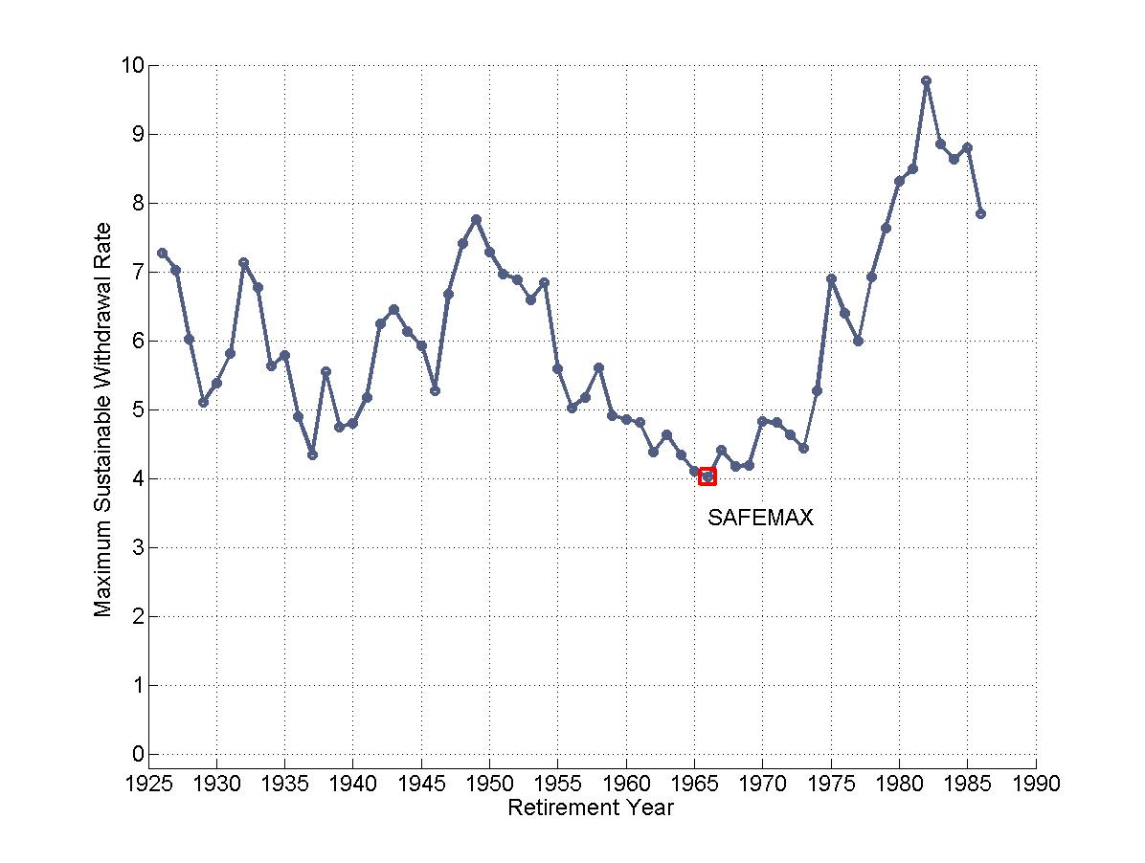
Basis for the 4% Rule
Maximum Sustainable Withdrawal Rates
For 50/50 Asset Allocation, 30-Year Retirement, Inflation Adjustments, No Fees
Using SBBI Data, 1926-2015, S&P 500 and Intermediate Term Government Bonds

Slide 19
Relationship between Interest Rates,
Planning Horizon, and Sustainable Spending for a 65-year old with $1 million
 |  | Fixed Return
 |  | 0% | 0.5% | 1.5% | 2.5% | 3.5% | 4.5% | 5.5%
Planning Horizon (Age) | 70 | $200,000 | $202,000 | $205,999 | $209,997 | $213,992 | $217,982 | $221,968
 | 75 | $100,000 | $102,259 | $106,832 | $111,472 | $116,175 | $120,937 | $125,751
 | 80 | $66,667 | $69,019 | $73,837 | $78,797 | $83,889 | $89,104 | $94,432
 | 85 | $50,000 | $52,404 | $57,385 | $62,583 | $67,982 | $73,566 | $79,317
 | 90 | $40,000 | $42,440 | $47,550 | $52,952 | $58,622 | $64,535 | $70,663
 | 95 | $33,333 | $35,800 | $41,024 | $46,612 | $52,533 | $58,748 | $65,218
 | 100 | $28,571 | $31,060 | $36,388 | $42,152 | $48,308 | $54,804 | $61,588
 | 105 | $25,000 | $27,508 | $32,933 | $38,865 | $45,244 | $52,003 | $59,071
 | 110 | $22,222 | $24,747 | $30,266 | $36,359 | $42,950 | $49,954 | $57,281

Slide 20
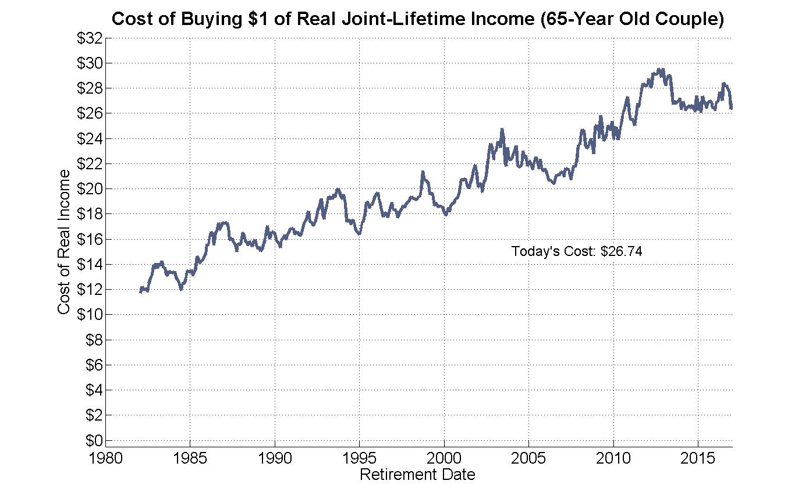

Slide 21
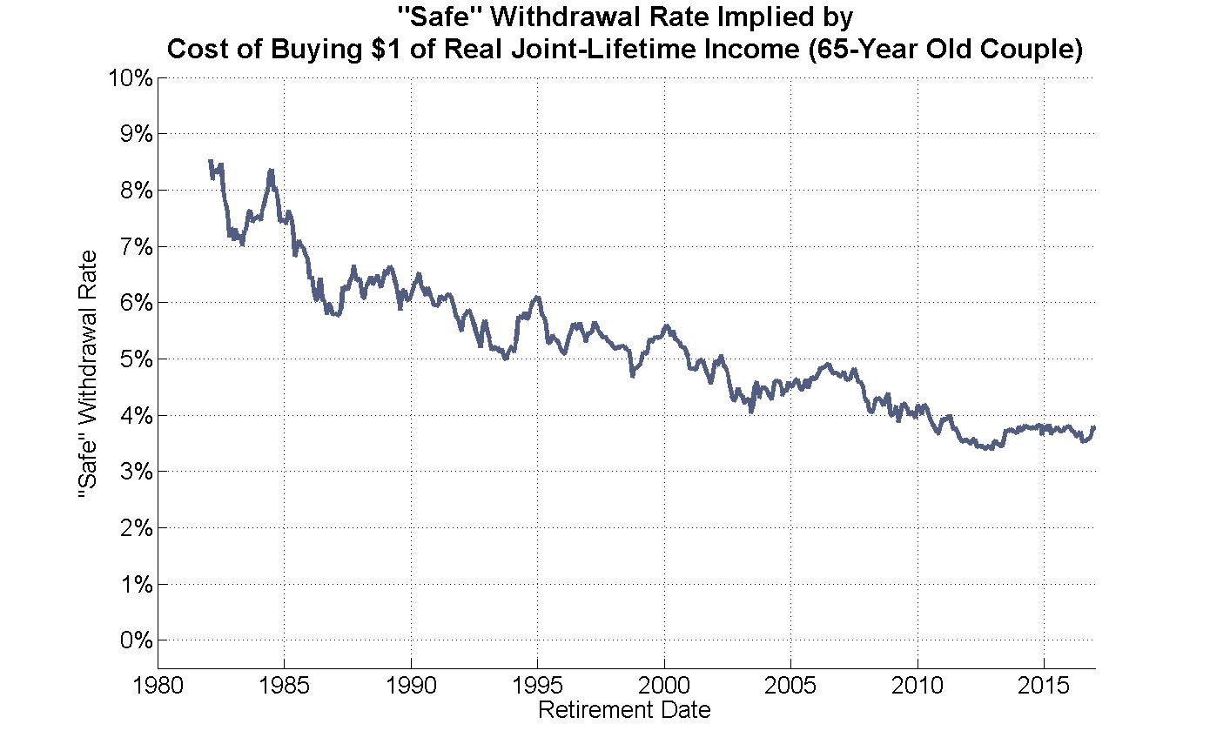

Slide 22
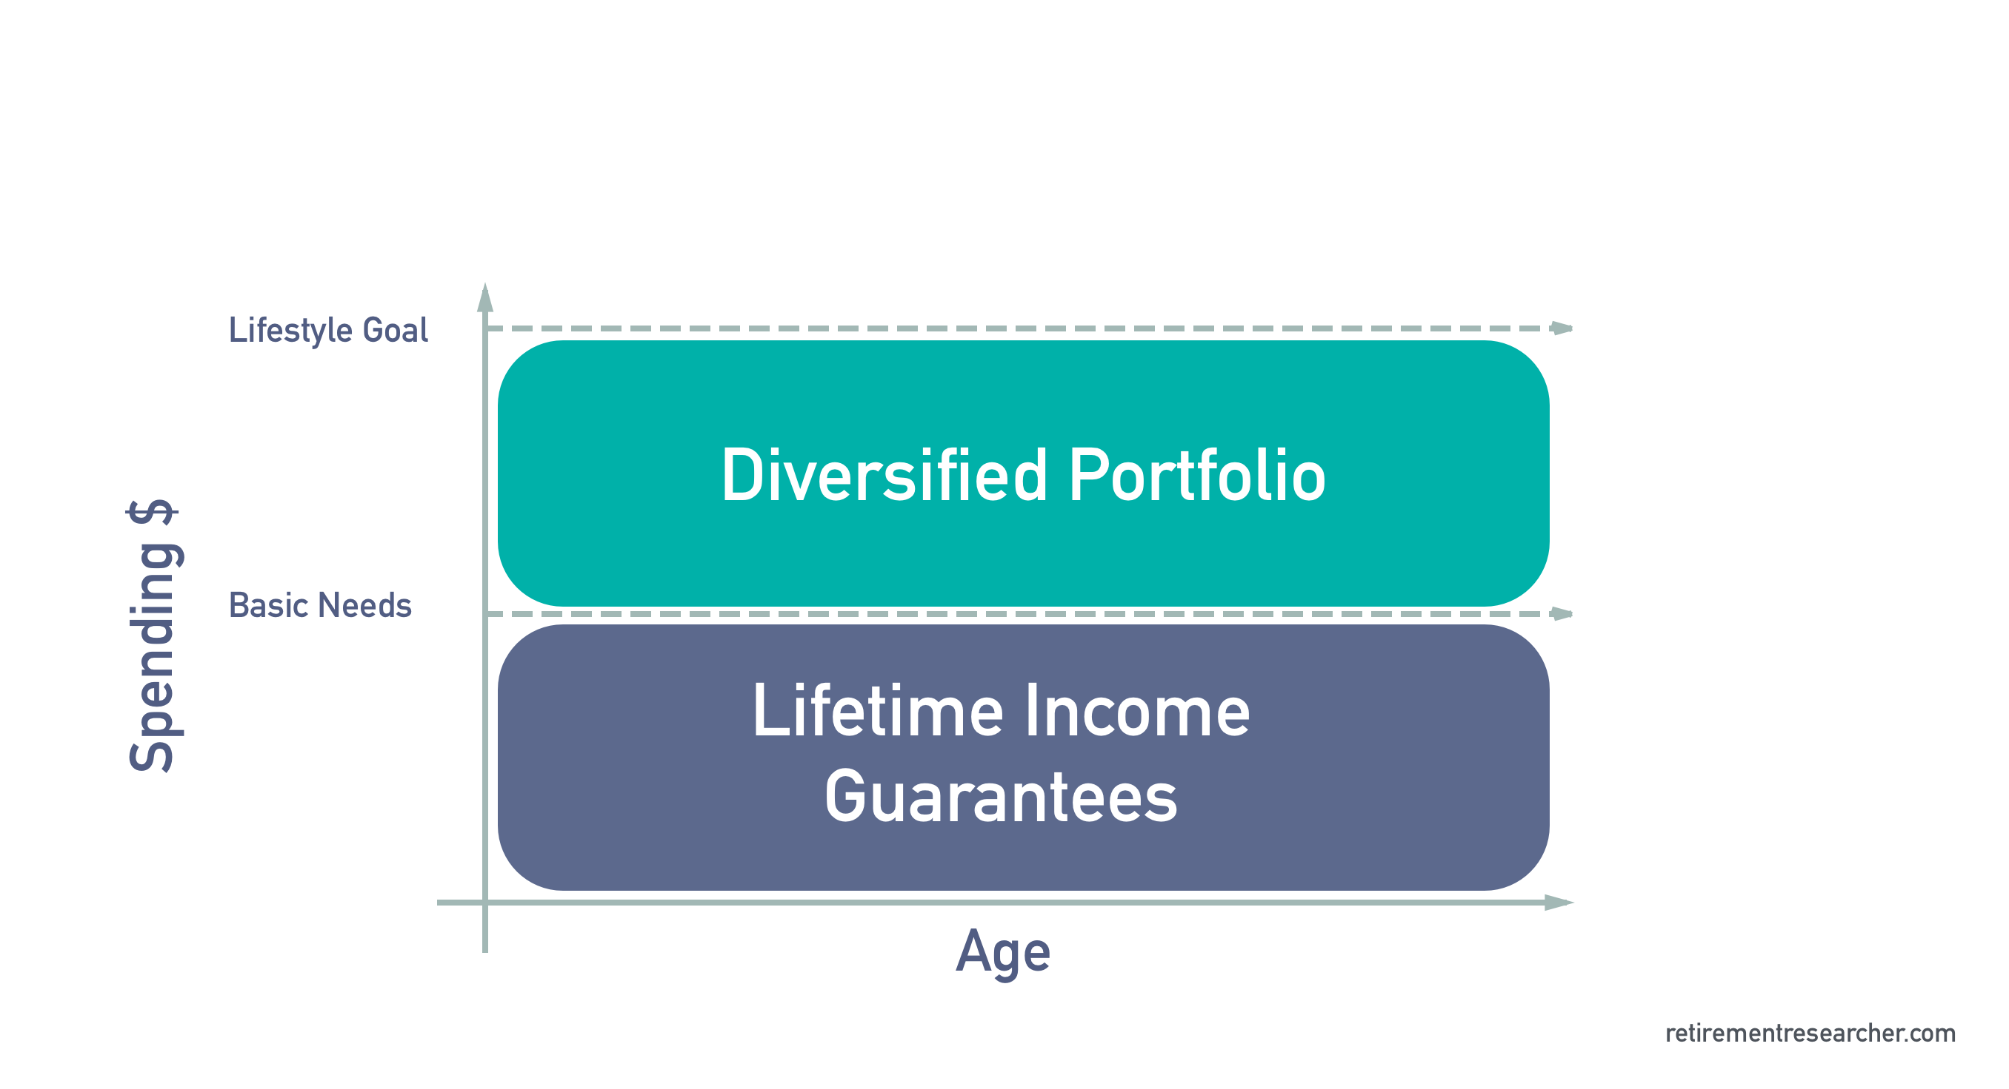
The alternative: Essentials vs. Discretionary

Slide 23
Household Balance Sheet
Assets |  | Liabilities
Human Capital |  | Fixed Expenses
 | Continuing Career |  | Basic Living Needs
 | Part-time work |  | Taxes
 |  |  | Debt Repayment
Home Equity
 |  | Discretionary Expenses
Financial Assets |  |  | Travel & Leisure
 | Checking Accounts |  | Lifestyle Improvements
 | Brokerage Accounts
 | Retirement Plans | Contingencies
 |  |  | Long-Term Care
Insurance & Annuities |  |  | Health Care
 |  |  | Other Spending Shocks
Social Capital
 | Social Security | Legacy Goals
 | Medicare |  | Family
 | Company Pensions |  | Community & Society
 | Family & Community

Slide 24
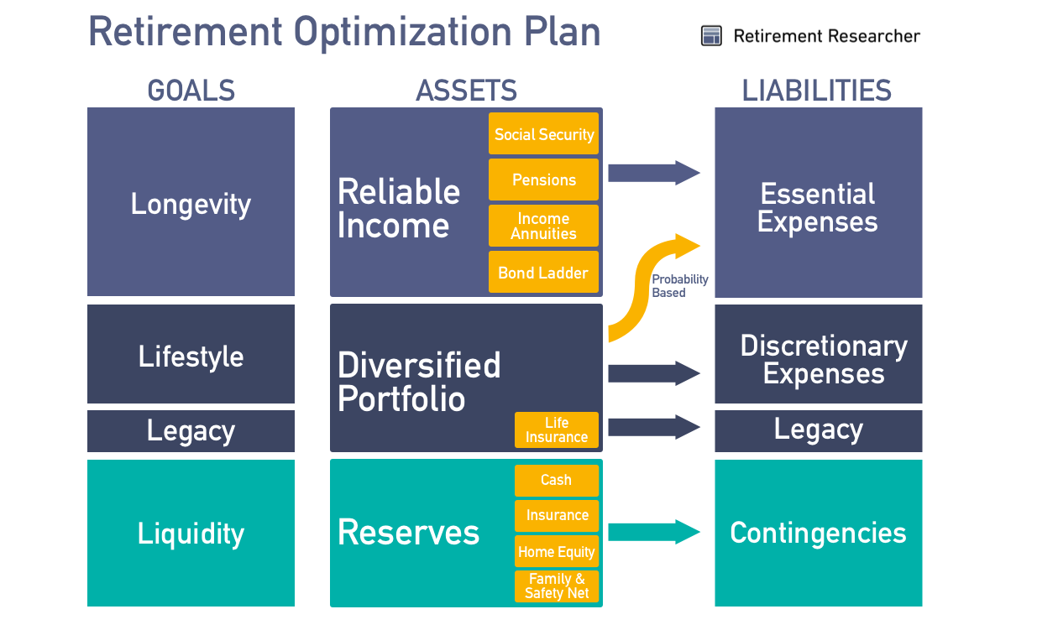
Model Portfolio

Slide 25
Product Allocation
Systematic Withdrawals
Income Annuities (SPIAs & DIAs)
Variable Annuities with Guaranteed Living Benefit Riders (GLWBs)

Slide 26
Sources of Investment Spending
Interest,
Dividends
Capital Gains
(Risk Premium)
Principal

Slide 27
Sources of Annuity Payments
Interest
Mortality
Credits
(Risk Pooling)
Principal
Survival-Weighted
Present Value of Cash Flows

Slide 28
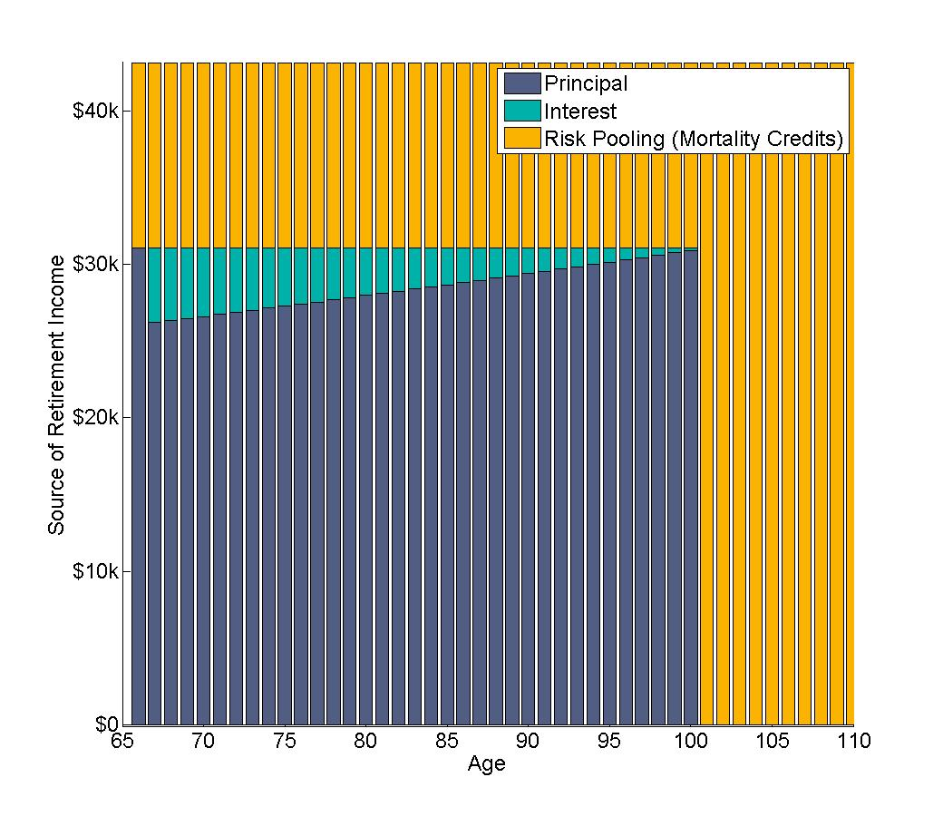
Income Sources for Income Annuity
Assumptions:
65-Year Old Female
Bond Ladder Planning Age: 100
0.5% fixed real yield curve
Society of Actuaries
Individual Annuitant Mortality Table
$43,118
$31,060

Slide 29
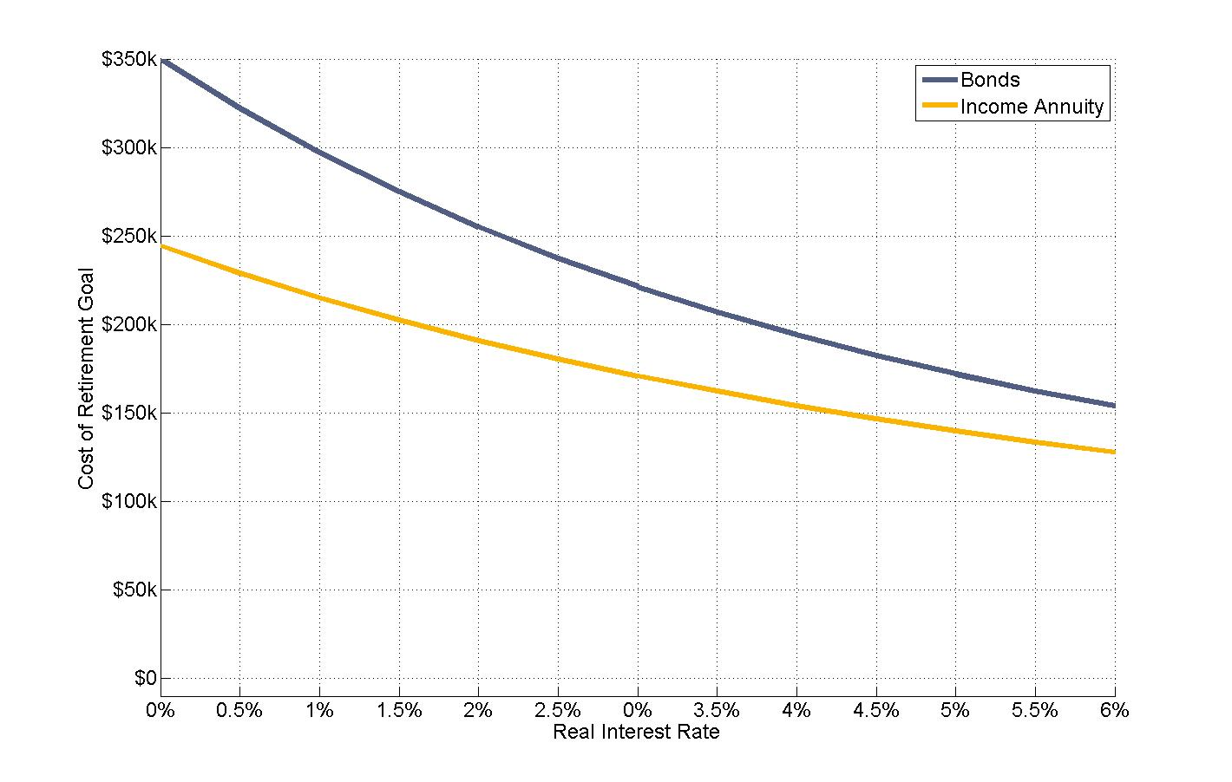
Cost of Funding a Real $10,000 Income Stream
41%
Assumptions:
65-Year Old Female
Planning Age: 100
Fixed real yield curve
at Interest Rate
Society of Actuaries
Individual Annuitant
Mortality Table
34%
28%
23%

Slide 30
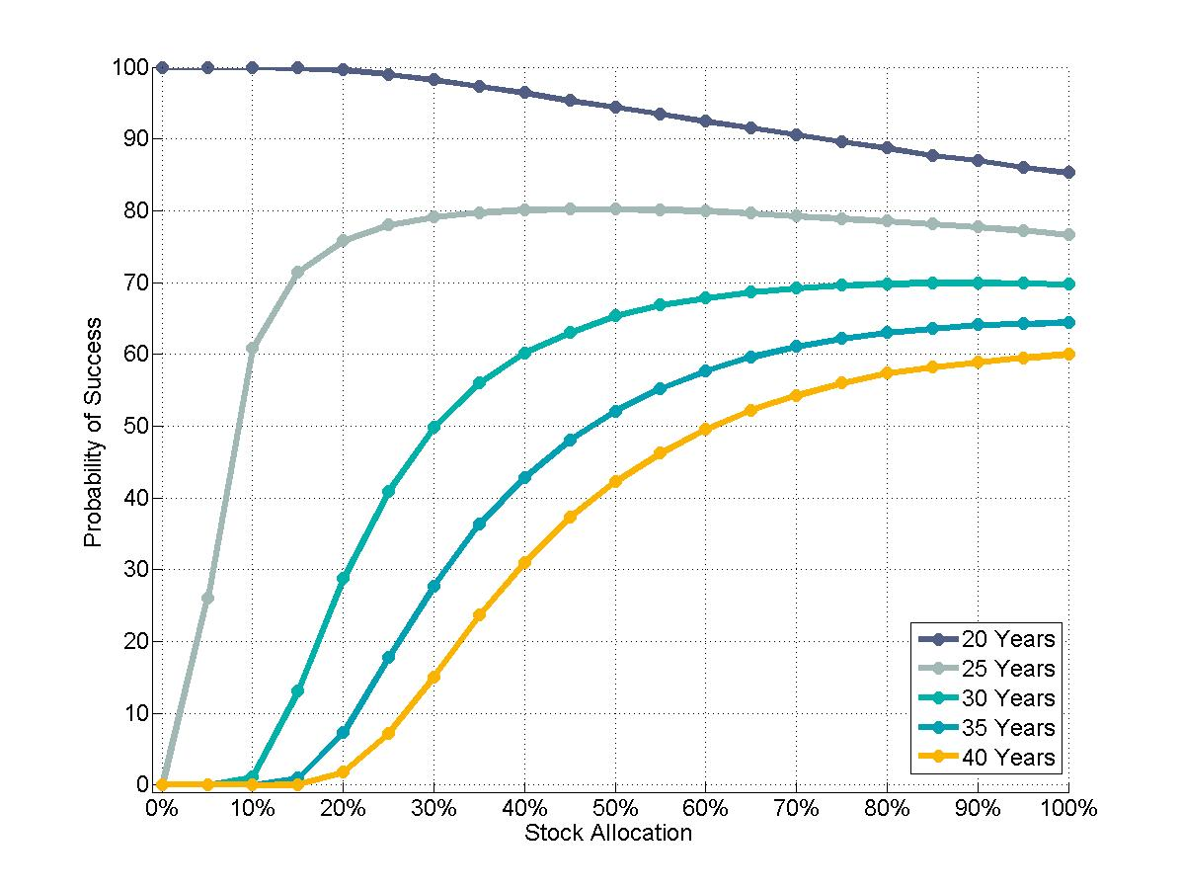
Probability of Success:
Funding Real $43,118 for Different Time Horizons
Source: Own calculations with 100,000 Monte Carlo Simulations for stock and bond portfolios. Bonds earn a
fixed real return of 0.5%. Stocks earn an arithmetic average real return of 6.5% with a 20% annual volatility.

Slide 31
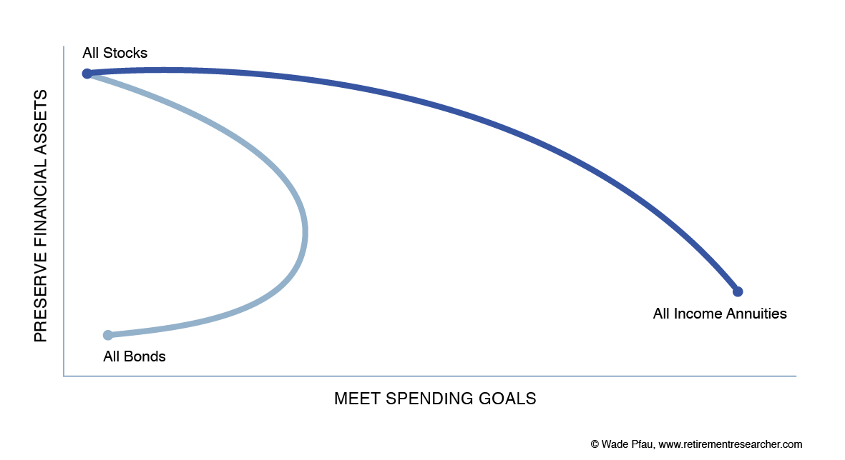

Slide 32
Key Takeaways
The financial planning problem fundamentally changes for retirees
Advisors who can help manage the varying retirement risks will be best equipped to help their clients with retirement income
Integrated strategies that combine insurance to meet spending goals and investments for other discretionary goals are more efficient

Slide 33
THANK YOU!
ANY QUESTIONS?
wade@retirementresearcher.com
@WadePfau (Twitter)
www.RetirementResearcher.com

