Slide 1


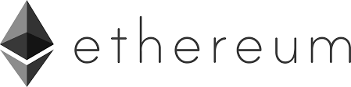
Northeastern Michigan Estate Planning Council
Cryptocurrency: What it is and what it is not
Mohamed Adel
Associate Director of Dow Entrepreneurship Institute at SVSU
October 27, 2022
Notes:
Cryptocurrency

Slide 2
Learning Outcomes:
How does Blockchain technology work?
How does Bitcoin mining work?
Become familiar with some of the terminology used.
Take a look at alternative technologies to the Blockchain.
Understand some of the fallacies associated with Blockchain technology.
How can the value of Bitcoin be estimated?
Find out how cryptocurrency and taxes work.
Notes:
Cryptocurrency

Slide 3
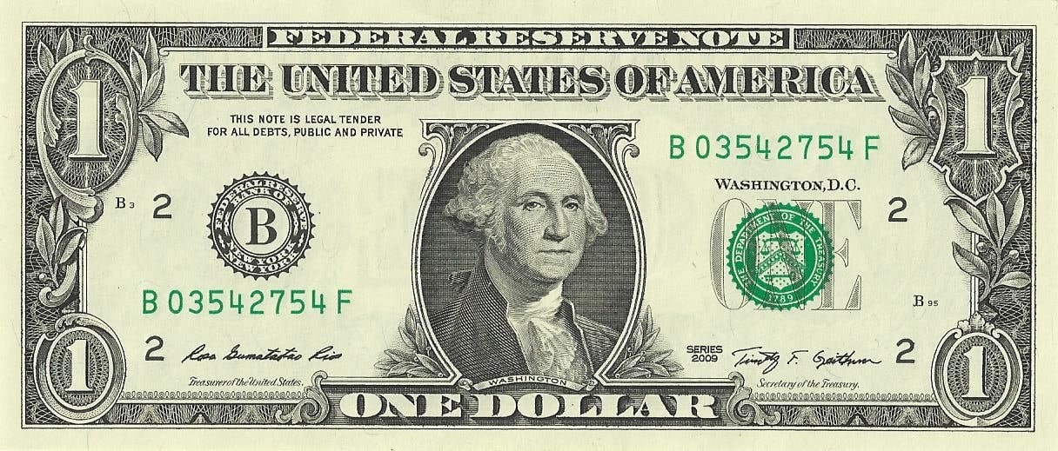
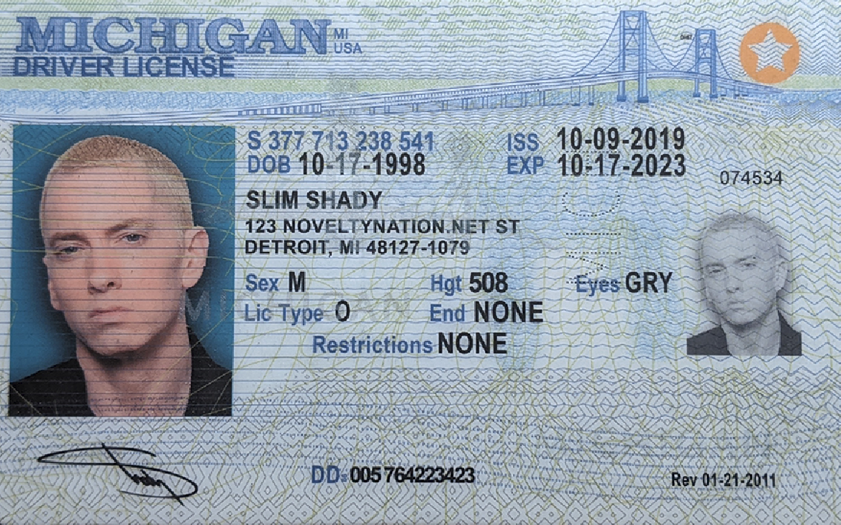

Blockchain: What exactly is it?
The Problem: How can we determine whether something in today's world is genuine or fake?
We maintain a record of it. Each dollar bill is assigned a serial number by the bank, driver's license numbers are recorded by the government (DMV), and voting records are used to determine who voted and did not vote.
In other words, to ensure a legitimate document, you should consult with the appropriate authority, or rely on licensed notaries to attest and record the validity of information.
Question: What do all these mechanisms have in common?
All of them are centralized. A bank, a government agency, or an individual has the authority to validate the information.
Notes:
Cryptocurrency

Slide 4
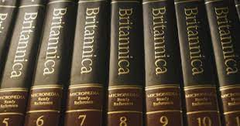

Blockchain: What exactly is it?
The Problem: Other applications of centralization.
Remember the Encyclopedia Britannica?
Over 4,000 contributors and 100 full-time editors contributed to what we consider the world's leading authority on knowledge.
Think of these editors' power to determine what is worthy of mention, condoning, condemning, or ignoring.
In 2010, Encyclopedia Britannica published its last volume.
Today, the information is much more decentralized; Wikipedia has more than 130 thousand active editors who maintain different Wikipedia pages.
Each edit is public and can be verified by anyone, there is a much smaller risk of any of them going rogue unnoticed.
Notes:
Cryptocurrency

Slide 5
Blockchain: What exactly is it?
The Problem of Centralization.
Spiderman's famous adage: "With great power comes great responsibility."
What happens if some central authority is corrupt and wish to alter the facts?
That's where the concept of a decentralized system becomes crucial, as it reduces corruption, fraud, and manipulation risks.
That's what Blockchain or Blockchain technology is trying to solve; the problem of centralization. Simply put, Blockchain or Blockchain technology is a new innovative method for implementing decentralization.
Notes:
Cryptocurrency

Slide 6

Blockchain: What exactly is it?
Why is it called Blockchain?*
Assume the following:
We maintain a shared ledger containing many pages of records.
Each page begins with a summary of the last page.
You will also need to change the summary on the current page if you change a part of the last page.
As a result, the pages are linked or chained together.
Note that in tech jargon, pages are called blocks, and since each block contains the previous block's data, we have a Blockchain.
Bitcoin was the first Blockchain implementation created by Satoshi Nakamoto.
[Bitcoin≠ Blockchain]
Summary
Block#300
Block#301
Last
Current
*A high-level explanation of what a blockchain consists of.
Notes:
Cryptocurrency

Slide 7
Blockchain: What exactly is it?
How does it work?
To understand how it works, we ask the following question:
If I want to create a system that allows everyone to produce, verify, and update records, how do I do it?
For a Blockchain to be successful, it must possess five key components as follows:
1) A peer-to-peer network.
2) Cryptography.
3) A consensus algorithm (rule).
4) Punishment and reward.
5) Market adoption.
Notes:
Cryptocurrency

Slide 8
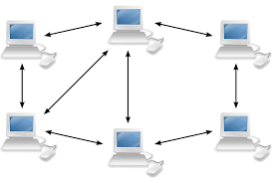
Blockchain: What exactly is it?
What is peer-to-peer network?
It consists of a network of computers (equally privileged nodes).
It is open to all.
In essence, this is what the Internet provides us with today.
Node 1
Node X
Why is it necessary?
To facilitate remote communication and sharing.
Notice that the network is open to everyone, including bad actors.
P2P Network
How can we be sure that your communications are not altered in any way?
Notes:
Cryptocurrency

Slide 9


Blockchain: What exactly is it?
Cryptography:
Securing communications in hostile environments.
The system allows you to verify messages and prove your own authenticity, even when malicious players are present.
Block#300
Block#301
Notes:
Cryptocurrency

Slide 10



Blockchain: What exactly is it?
Consensus Algorithm (Rule):
The nodes can agree on the rules regarding adding a new page (block) to our records.
There are several types of consensus rules. Bitcoin uses a consensus algorithm called Proof of Work (PoW).
What is PoW?
The computers connected to the network run calculations to solve math problems, consuming a lot of energy. Therefore, they perform a large amount of work.
Consequently, when one finds a number that solves the problem and displays it to the network, they show "proof of work."
As if the node is saying: "Hey, I spent quite a bit of time and effort solving this problem, so I am entitled to write the next page."
Notes:
Cryptocurrency

Slide 11
Blockchain: What exactly is it?
Punishment and Reward:
Derived from game theory.
Ensures that following the rules will always be in the interests of the participants. In other words, the system's rules become something participants want to follow rather than something participants must obey.
How does it work?
We set up a network that can communicate securely and follows a set of rules for reaching a consensus.
As a way of tying these components together, we will provide rewards to those who assist us in maintaining our records and adding new pages.
The reward/prize is in the form of a token or coin.
The reward is awarded each time a consensus is reached, and a new block is added to the chain.
In contrast, bad actors who attempt to fool or manipulate the system will lose the money they spend on computational power.
Notes:
Cryptocurrency

Slide 12
Blockchain: What exactly is it?
Market Adoption:
A group of ten people can share a ledger using a consensus algorithm, but this does not constitute a decentralized system since not enough participants are involved.
Additionally, if our coin is not adopted, it has no value, and punishment and reward is ineffective.
For a blockchain to become genuinely decentralized and immutable, it must reach a critical mass of users. As a result, the blockchain coin typically begins to appreciate at that point.
It is difficult to predict what triggers mass market adoption.
Initially, bitcoin was used on the dark web to purchase drugs and other illegal goods. People have begun searching for bitcoin and Blockchain and have seen their benefits in their daily lives or as investments.
Notes:
Cryptocurrency

Slide 13
BTC Mining: What exactly is it?
BTC is born through miners. Who can mine? Anyone who wishes to update the ledger of BTC transactions (Blockchain) may do so. You only need to guess a random number that solves a math equation (hash) generated by the system.
Upon making a correct guess, you are entitled to write the next page on the Blockchain.
As soon as you create a block, it is sent to the entire network so that other computers may validate it. Upon validation, each computer updates its copy of Blockchain ledger.
In exchange for the time and energy you spend on solving the math problem, the system rewards you with a fixed amount of BTC. You will also receive any transaction fees associated with the transactions you inserted into this block.
As part of their compensation, miners receive seignorage (the market value of a bitcoin minus the mining costs) and transaction fees upon validation — to switch to transaction fees only after the coins, which are limited in number, are depleted.
Notes:
Cryptocurrency

Slide 14
BTC Mining: What exactly is it?
Some Mining Rules:
The more mining power the network has, the more difficult it is to guess the answer to the mining math problem. As a result, the difficulty is self-adjusting as the mining power of the network increases. This is referred to as the mining difficulty.
It is highly unlikely that the same miner will do so each time.
Why is it designed like that? To create a steady flow of BTC into the system.
Mining Processing Power:
CPU mining.
GPU mining.
FPGA (Field Programable Gate Array) mining.
ASIC (Application-Specific Integrated Circuit) mining, this is the current mining standard.
[In 2009 you could mine 200 BTC in few days on your PC. In 2014, it took 98 years to mine 1BTC]
Notes:
Cryptocurrency

Slide 15
BTC in Numbers:
The maximum total supply of Bitcoin is 21 million.
As of October 21, 2022, there were 19,182,792 bitcoins in existence. As of that moment, 1,817,208 bitcoins remain to be mined before the 21 million bitcoin limit is reached.
It is expected that the final bitcoin will not be generated until 2140, as the number of new bitcoins issued per block decreases by half approximately every four years.
There are approximately 10 new bitcoins added to the Bitcoin supply every 10 minutes, which is the average amount of time it takes to create a new block of Bitcoin.
Every 210,000 blocks, or every four years, the number of bitcoins minted per block is reduced by 50%.
When Bitcoin was first established, 50 new bitcoins were minted per block. As of May 2020, the number has decreased to 6.25.
Bitcoins are not expected to reach 21 million in total. Bitcoin uses bit-shift operators, which perform arithmetic operations such as rounding decimal points to the nearest integer. The reward can be expressed in satoshis, with one satoshi equal to 0.00000001 bitcoins.
Notes:
Cryptocurrency

Slide 16
What is Ethereum?
Decentralization is the distribution of power away from a central authority.
BTC decentralizes money from the government.
Ethereum decentralizes authority from intermediaries.
Fixed, Bob send 1 BTC to Scott.
Allows decentralized applications DApps to be built on top of it.
Bitcoin is the native cryptocurrency.
Ether (ETH) is the native cryptocurrency. This is what keeps the technology running. Other cryptocurrencies: Uniswap, SushiSwap, Synthetix.
1 million daily active users.
0.4 million daily active users, and about 3000 DApps.
Limited amount; 21 million BTC.
Unlimited amount. Limited supply of 18 million ETH/Year.
Notes:
Cryptocurrency

Slide 17
What is Ethereum?
If you buy a house, you pay with BTC and use Ethereum to create a series of smart contracts that help move to close, like title insurance.
What is a smart contract? A computer program that directly controls digital assets.
On BTC/Blockchain Bob sends 0.08 BTC to Scott.
On Ethereum, you can add a contingency to the transaction; Bob sends 8 ETH to Scott for eight days. You have programmable money with Ethereum.
Think of BTC/Blockchain as a challenge to the banking and payment industry, while Ethereum is a challenge to the insurance industry (risk management).
You can create any assets on Ethereum and trade them; this is called tokenization, like NFTs.
Non-Fungible Tokens (NFTs) are unique, easily verifiable digital assets that live on the Blockchain.
Note: Cryptocurrency (BTC, ETH, etc.) is the native asset of a Blockchain, whereas a token is built on an existing Blockchain using smart contracts.
Notes:
Cryptocurrency

Slide 18
The Blockchain Killer!
Hedera hashgraph is a decentralized public network and governing council, including Boeing, IBM, Google, LG, and many more.
Created by Dr. Leemon Baird in 2016.
It is the only platform that uses the Hashgraph algorithm with its native token, HBAR.
The Hashpraph algorithm is based on the gossip-about-gossip protocol. The data structure comprises spherical container events, gossiping across the network's nodes. Think of notes along a musical scale.
More than 300 applications are built on HBAR.
Notes:
Cryptocurrency

Slide 19
The Blockchain Killer!
Speed
7 Trx/S
15 Trx/S
10K Trx/S
$0.0001
Does not change depending on network demand or usage.
No miners to compensate for their work.
Trx Fees
$0.03 - $10.0
Data Structure/ Network Architecture
Blockchain based, where miners sequencing data block after block in a POW.
DAG
(Directed Acyclic Graph)
aBFT
(asynchronous Byzantine Fault Tolerance)
Security
POW
Notes:
Cryptocurrency

Slide 20
Debunking Concepts?
Decentralization: Does the music match the words?
What is Web3?
What is Web2? Simply, it is the current web, dominated by centralized platforms such as Google, Apple, and Facebook, etc.
It is a decentralized version of the internet in which users build and own platforms and apps.
It will use blockchain, crypto, and NFTs to restore power to the internet community.
“… Of the people, by the people, for the people”
Date | 10/21/22
1 BTC | $19,149.01
Addresses | 43.2 million
Coins | 19.2 million
Market cap | 367 billion
BTC Supply
BTC Ownership
Notes:
Cryptocurrency

Slide 21
Debunking Concepts?
The Dependency on Miners:
To validate transactions, Bitcoin relies on miners. A critical weakness in the bitcoin ecosystem is miners' lack of sufficient incentives. There must be a sustained amount of interest in cryptocurrency.
On the other hand, gold and other precious metals are essentially maintenance-free, do not degrade over time, and do not require maintenance to maintain their physical properties.
Comparing Bitcoin to Gold:
Gold and other dividend-free precious items have held some financial status for thousands of years, as well as their physical quality. One can expect gold and silver to be around physically for al least the next millennium.
About half of gold production currently goes to jewelry (for which there are often no storage costs), and a quarter to central bank reserves, and the remaining for industrial uses.
Bitcoin as a Store of Value:
For something to qualify as currency or numeraire (a piece of property or commodity that serves as a measure of value or as a standard for currency exchange), it must be a benchmark that maintains stability against which items can be priced.
Notes:
Cryptocurrency

Slide 22
Debunking Concepts?
Valuation Concerns:
There are two main reasons why bitcoin has no value:
First, it does not offer any explicit yield to its holders today; in other words, it does not pay dividends.
Second, future events may render bitcoin worthless, for example, miners going extinct or losing interest, or technology becoming obsolete due to other more efficient methods of transferring value or storing it. This is known as an absorbing barrier.
If a non-dividend-paying asset has the slightest chance of hitting an absorbing barrier, its present value must be zero.
Crypto Scamming:
Crypto scammers took a record $14 billion in 2021.
Losses from crypto-related crime rose 79% from 2020.
Cryptocurrency theft increased 516% from 2020, to $3.2 billion worth of cryptocurrency.
Notes:
Cryptocurrency

Slide 23
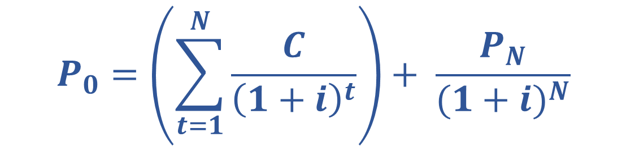
Debunking Concepts?
How do you estimate the value of an asset? An example would be a bond, equity, a business, real estate, etc.
$$P_{0}=\left(\sum_{t=1}^{N}{\frac{C}{{\left(1+i\right)}^{t}}}\right)+ \frac{P_{N}}{{(1+i)}^{N}}$$
$$P_{0}=Series of cash flows+Expected price in the future$$
Zero
Zero
Absorption barrier: interruption of the ledger updating process, loss of interest, tech replacement. For the price to be positive it must grow forever!
Notes:
Cryptocurrency

Slide 24
Crypto Investing and Taxes
Compounding and the Effect of Taxes:
Suppose you double the $1 for 20 years without paying any taxes, compared to a 25% tax rate. There is a 93% drop in value.
Notes:
Cryptocurrency

Slide 25
Crypto Investing and Taxes
Long-term capital gains (t>= 12 months) (0% - 20%).
Short-term capital gains (t< 12 months) (10% - 37%).
IRS Triggers:
Sell crypto/token back to USD.
Trade crypto/token for another.
Purchase with crypto/token (Use BTC to buy a land in the Metaverse).
Tax vehicles:
IRAs, 401K.
Roth IRA.
Self-direct IRA, if IRA provider does not allow direct investing in cryptocurrency.
Notes:
Cryptocurrency

Slide 26
References:
Notes:
Cryptocurrency

