Slide 1
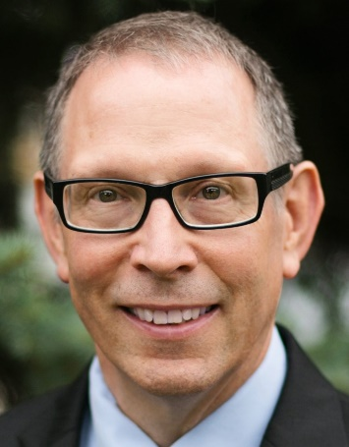

How to Avoid and What to do if Audited by the IRS
Redwood Empire EPC
February 1, 2023
By
Michael Gregory

Slide 2


Slide 3

Disclaimer
The opinions presented here are those of Michael Gregory. Any opinions presented in this seminar are those of the author and do not represent an official position of his current or previous employers. This material is offered for educational purposes only. The author and his employer expressly disclaim any liability, including incidental or consequential damages, arising from the use of this material or any errors or omissions that may be contained in it.

Slide 4
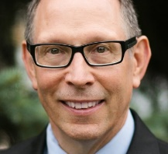
Michael Gregory
Founder of Michael Gregory Consulting a firm focused on collaboration, conflict resolution, and speaking
ASA and CVA
28 years at the IRS
Headed up business valuation at the IRS for 11 years
Qualified Mediator with the MN Supreme Court 19 years
Testified in U.S. Tax Court – ran litigation team with 21 experts 7 years
Over 2,500 mediations, negotiations, facilitations
12 books and over 45 articles

Slide 5

As a Result of Today’s Presentation You Will Be Able to:
Address pertinent changes at the IRS
Describe how the IRS works and how to work with this IRS
Communicate how classification works at the IRS on estate and gift tax audits, and how to avoid an audit
Identify how to work with IRS personnel if audited
Apply The Collaboration Effect and three bonus items

Slide 6
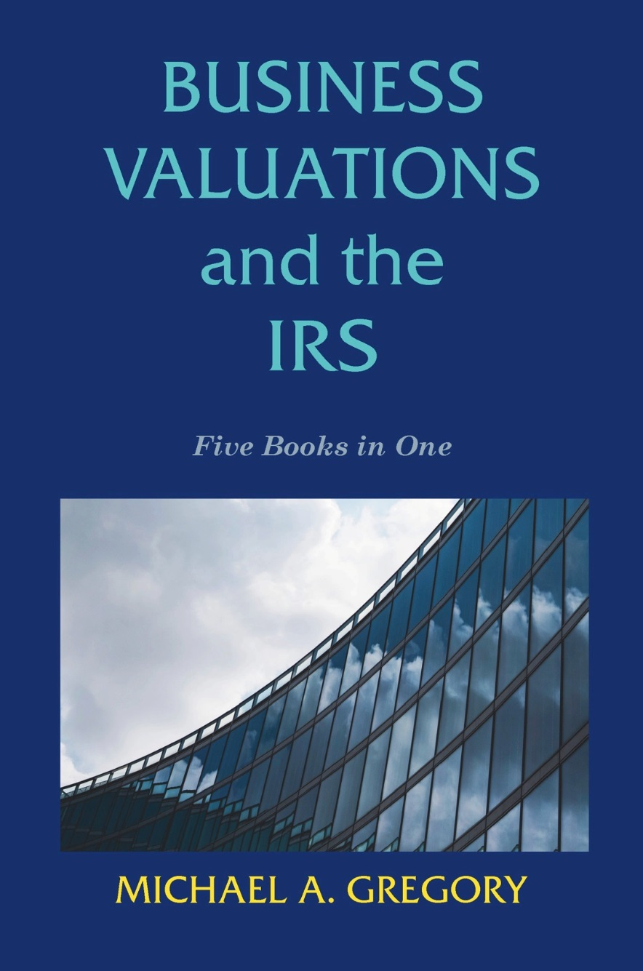

Slide 7
Business Valuations and the IRS:
Five Books in One
852 Pages with 38 Examples and over 180 Practical Pointers
Part One: IRS Structure and Process
Part Two: Resolving Conflict with the IRS
Part Three: Valuing Non-Controlling Interests in S-Corps
Part Four: Valuing Reasonable Compensation and the IRS
Part Five: Discount For Lack of Marketability and the IRS

Slide 8

The IRS Big Picture
Notes:
IRS Founded in 1913 with 16th Amendment
Hired First “Engineers” in 1914
Today 280 “Engineers”
180 with Credentials in Valuation
Specialists in IRS
1913 to 1999 Organization
2000 to Now Organization
Small Business Self Employed
Large Business and International
Tax Exempt and Governmental Entities
Wage and Investment

Slide 9
Introduction
What the IRS is intending to do in 2023
What are the implications?
What should you do?

Slide 10
What the IRS Intends to Do
Quality Audit
Quantity of Returns
Taxpayer Bill of Rights IRS Publication 1

Slide 11
The IRS Today
The IRS was behind 21 million pieces of mail – today ?
2.4 million paper returns from 2019
1.7 million returns were in the error resolution unit
2.5 million cases are in its account's management unit
1.6 million returns are flagged for fraud
Recent IRS hires of Engineers and Business Valuers

Slide 12
Where to File Estate and Gift Tax Returns
Form 706 and 709
Effective January 1, 2019
Department of the Treasury
Internal Revenue Service Center
Kansas City, MO 64999
If submitting Form 706 or709 by private delivery service, mail to:
Internal Revenue Service
333 W. Pershing Rd
Kansas City, MO 64108

Slide 13

Classification of
Estate and Gift Tax Returns
National Classification Process – Kansas City now versus Cincinnati
Local Classification Process

Slide 14

IRS Most Significant Issues Adjusted on Business Valuation Cases in 2021
Discounts
Reasonable Compensation
S-Corps
Common Errors

Slide 15
Historical Perspective of
E&G Filings and Audits
Category | Year | Year | Year | Year
 | Totals | % Audited | Totals | % Audited
 | 2017 | 2018 | 2018 | 2019
< $ 5 Mil | 23,013 | 2.5% | 19,025 | 2.0%
$5M<x<$10M | 8,095 | 13.4% | 8,837 | 9.2%
>$10 Mil | 3,934 | 31.0% | 4,975 | 21.7%
Estate Totals | 35,042 | 8.2% | 32,847 | 6.9%
Gift Totals | 244,974 | 0.8% | 244,770 | 0.8%

Slide 16
Category |  | Year | Year | Year |  | Year | Year | Year |  | Year | Year
 |  | % Audited | % Audited | % Audited |  | Totals | Total | Totals |  | Avg Add Tax | Avg Refund
 |  | 2018 | 2019 | 2020 |  | 2018 | 2019 | 2020 |  | 2020 | 2020
<$5 Mil |  | 2.5% | 2.0% |  |  | 19,025 |  |  |  | $ 130,297 | $ 291,200
$5M = x < $10 M |  | 13.4% | 9.2% |  |  | 8,837 |  |  |  | $ 90,018 | $ 124,724
>=$ 10 Mil |  | 31.0% | 21.7% |  |  | 4,975 |  |  |  | $ 407,983 | $ 502,295
Estate Totals |  | 8.2% | 6.9% | 10.0% |  | 32,847 | 25,742 | 15,023 |  | $ 263,800 | $ 366,505
Gift Totals |  | 0.8% | 0.8% | 0.8% |  | 244,770 | 239,618 | 158,095 |  | $ 216,127 | $ 468,262
Notes:
History of IRS Exemptions.
2016 $5,450,000
2017 $10,000,000
2018 $11,180,000
2019 $11,400,000
2020 $11,580,000
2021 $11,700,000

Slide 17
Some Other Interesting Facts from IRS Data
For Estate Audits 18% are No Changes
For Estate Audits 20% are Refunds
Additional Tax Adjustments for Estates Amount to on Average
  $126,000 for under $5 million estates
  $ 88,000 for $5 million up to $10 million estates
  $335,000 for over $10 million estates
For Gift Audits 43% are No Changes
About 5% of Gift Cases Have Valuations. If 50% of Change Cases Are Valuations this Amounts to Approximately 5% Chance of Being Audited

Slide 18
Estate and Gift Tax Ramifications
Goal to close cases in 6 months
Goal to close out so many cases in FY 2022
  October 1, 2022 to September 30, 2023
  It takes a month to close a case
  Complete closed cases by no later than August 31 for year end
    This means an agreed case with the closing letter
    This means an unagreed case closed out of the group with the 30-day letter response to Appeals
  If a case has less than 9 months on the statute when it arrives at Appeals, it will not be accepted – docket for court
Quantity goal
Quality goal - TCJA

Slide 19
Given IRS Budget
  Quality will suffer
  Taxpayer Bill of Rights IRS Publication Number 1
  LB&I IRM 4.46.4.6 (12-13-2018) Information Document Request Process with Exhibit 4.46.4-1
Quantity – will not meet targets, but will try valiantly to meet targets
  Outside of Business Valuation Observations

Slide 20
What Should You Do Relative to Valuations?
Have a qualified appraisal by a qualified appraiser and attach it to the return
Understand how the IRS looks at them and plan accordingly
Consider behavioral elements on audit
Don’t be afraid to go to Appeals

Slide 21

Pertinent Federal Court Cases on Business Valuation
Nelson v. Comm TCM 2020-81, 17 F4th 556 (5th Cir 2021 Win of BV for TP)
Estate of Michael Jackson May 3, 2021 (Corp) Win for TP
Estate of Warne February 18, 2021 Win for TP
Lucero v. U.S. October 27, 2020 Win for TP
Pierson M. Greive v. Comm March 2, 2020 Win for TP
Estate of Aaron U. Jones August 19, 2019 (Corp) Win for TP (1120S)
Kress v. Comm March 26, 2019 (Corp) Win for TP (1120S)
Estate of Gallagher June 28, 2011
Guistina TC Memo 2011-141 (Limited Partnership)
Dallas T.C. Memo 2006-212 (Corp)
Adams T.C. Memo 2002-80 (Corp)
Heck T.C. Memo 2002-34 (Corp)
Wall TC Memo 2001-75 (Corp)
Gross v. Commissioner T.C. Memo 1999-254, aff’d 272 F. 3d 333 (6th Cir. 2001cert denied, 537 U.S. 827 (2002) (Corp)

Slide 22
Nelson v. Comm
Valuation of a holding company
Minority interest discount
Discount for Lack of Marketability
Formula gift clause win for IRS – The drafting of the defined benefit clause was critical in this instance
IRS expert preferred with quantitative models
Restrictions imposed by Caterpillar limits the sale to NAV
TP lost the battle, but won the war
  TP lost on the defined benefit clause 5th circuit
  TP valuation only 22% higher than the filing value

Slide 23
Michael J. Jackson
Asset | Estate | Commissioner | Tax Court | Percentage for the Winner
Jackson’s Image and Likeness | $3,078,000 | $161,307,045 | $4,153,912 | 99% TP
New Horizon Trust II 50% Interest in Sony/ATV | $0 | $206,295,934 | $0 | 100% TP
New Horizon Trust III Mijac Music | $2,267,316 | $114,263,615 | $107,313,561 | 94% IRS
Total | $5,345,316 | $336,866,594 | $111,467,473 | 68% TP

Slide 24
Estate of Michael Jackson v. Commissioner,
T.C. Memo 2021-48 (May 3, 2021)
  Judge Holmes
  And we find, as we have done consistently in the past apart from Estate of Jones, that by a preponderance of the evidence tax affecting is not appropriate here because the Estate has failed to persuade us that a C corporation would be the hypothetical buyer of any of the three contested assets.
  We do not hold that tax affecting is never called for. But our cases show how difficult a factual issue it is to demonstrate even a reasonable approximation [*83] of what that effect would be. In Estate of Jones, there was expert evidence on only one side of the question, and that made a difference.

Slide 25
But First Key Points from the Estate of Gallagher Case TCM 2011-148
Write a Report for the Court and Judge
Read Court Cases by Judge on Topic
What Did Judge Halpern Have to Say?
  Report is Testimony Have to Work with What I Have
  Should NOT Have Used WACC in This Instance
    Not Going Public and Do Not Meet Assumptions for WACC
    Use Equity Approach
  Do Not Use CAPM or Modified CAPM for the Discount Rate
    Same Concerns As Above
    Use Build Up Method

Slide 26
What Did Judge Halpern Have To Say Continued
  Gross Still Governs – “We Will NOT Impose an Unjustified Fictitious Corporate Tax Rate” – IRS is 6 for 6 in Court
  Don’t Assume Judge Understands Valuation Concepts
  Understand Discovery Rules and Process and Work with Attorney
  Have a Third Party Review Your Report
  Provide Court with Evidence: If It Is Not In Evidence It Does Not Exist - Valuation Text Book for Example
  Your job is to EDUCATE THE COURT

Slide 27
Estate of Warne v. Commissioner,
T.C. Memo 2021-17 (Feb. 18, 2021)
LLC operating agreement gave significant power to the majority interest holder; family trust had majority interest in every LLC
Court values not was contributed, but what charity received
Here is a detailed analysis for DLOC for a majority interest
Using data and thoroughly supporting in a report will win
TP 5% to 8% Mergerstat Control Premium Study – considered factors specific LLC
IRS 2% closed in funds dissimilar to subject – took bottom of range - court rejected
Court 4%
Court stated previously no DLOC for majority interest, in this case slight discount based on DLOC’s by both parties

Slide 28
Lucero v. United States,
U.S. District Court for the District of New Mexico,
October 27, 2020, Civ. No. 17-1065 JCH/JFR
TP claimed refund from $2.38/sh to $0.57/sh
Prior court settlement – compulsion at play in court case -$2.38/sh
Valuation date August 2014 – negative cash flow from beginning 2011 accumulated $608 million
Four valuations January to July 2014 $3.53/sh to $4.10/sh; Sept 2015 redeemed for $.48/sh
TP expert appraisal negative cash flows, used Altman Z-score bankruptcy probability, DLOM 18%, DLOC 25%
IRS review with opinion of value from exam and court case, agreed with discounts
Court 100% for TP

Slide 29
Lucero v. United States,
U.S. District Court for the District of New Mexico,
October 27, 2020, Civ. No. 17-1065 JCH/JFR
Expert testimony by TP with full appraisal
IRS supplied a review with an opinion of value – totally discredited by the court
IRS used a court case determination from litigation where one part was under duress - totally discredited by the court
Implications at the IRS

Slide 30
Pierson M. Grieve,
T.C. Memo. 2020-28 (March 2, 2020)
FMV of gift of 99.8% nonvoting interest in a GRAT Trust and Irrevocable Trust
FMV by TP Expert
  Used market and income approaches
  Used closed end funds for DLOC
  Used restricted stock studies for DLOM
FMV by IRS Expert – A willing seller would attempt to take control – concluded a premium to buy out and take control of the controlling interest
Court – no facts to support IRS theory – facts run contrary to IRS theory – not reasonably probable – no evidence of peer review methodology

Slide 31
Pierson M. Grieve,
T.C. Memo. 2020-28 (March 2, 2020)
Cash, cash equivalents, and marketable securities
Discounts total 35% at issue
Court firmly rejected Government’s assertion that 99.8% would buy 0.2% controlling interests – hypothetical with no basis in facts.
Valuations very similar - went with original valuation by TP and did not criticize the NICE method; government witness took issue with holding period, but not approach
No issues raised on the valuations of the entities, so the court did not have to address tax affecting by the TP’s expert

Slide 32
Estate of Aaron U. Jones,
T.C. Memo 2019-101
Seneca Saw Mill (SSM)
Seneca Jones Timber Company, LP
Gifts of stock May 28, 2009
Mr. Jones died September 14, 2014
Valuing both entities for gift and estate
Findings SSM – Government no appraisal argued law, TP won with tax affecting
Findings SJTC – Operating vs. Holding Co., TP tax affected and 22% premium; Government did not tax affect – “Mr. Reilly may not be exact, but it is more complete and more convincing than respondent’s 0% tax rate”.

Slide 33
Estate of Aaron U. Jones
T.C. Memo 2019-101 (Aug. 19, 2019)
Valuation of SSC lumber mill and STJC timberlands May 28, 2009
IRS SSC no valuation, STJC argued law not facts – tax affecting accepted
TP Experts $21 M and IRS $141 M operating vs. holding company
Category | Columbia (original) | Willamette | IRS | Court
SSC A voting | $325 | $390 | $1,395 | $390
SSC B nonvoting 1 | $315 | $380 | $1,325 | $380
SSC B nonvoting 2 | $315 | $380 | $1,325 | $380
SJTC limited partnership | $350 | $380 | $2,511 | $380
Rifle Range |  |  | $4.20 (1%) | $4.20
Notes:
“Mr. Reilly’s tax-affecting may not be exact, but it is more complete and more convincing than respondent’s zero tax rate.”

Slide 34
Kress v. United States,
March 26, 2019
U.S. District Court Case litigated by the Department of Justice Tax Litigation Division
Both parties' tax affected cash flows minority owned shares
Government’s expert applied an S corp premium to account for perceived tax advantages – court declared itself neutral on this issue
Note: not a U.S. Tax Court or U.S. Court of Appeals decision
Note: Court did not address the issue of tax affecting in the opinion
Note: The government gave recognition to tax affecting

Slide 35
What is Mediation and a Mediator
Mediation
  Evaluative
  Facilitative
  Transformative
Mediator
  Qualified Mediator
  True Neutral

Slide 36

Thanks, Neuroscience!
Ericka Garms, PhD U of MN and Her Team, Neuroscientist
John B. Molidor, PhD Assoc. Dean MSU Medical School
Rick Hanson, PhD Psychologist, Greater Good U of CA Berkeley
Terry Wu, PhD Vanderbilt, Neuroscientist
Notes:
5/15/10
Mindfulness
More sleep
The right foods
Three keys
Attention and focus
Priorities
Energy – Resources
SCARF Model
Status
Certainty
Autonomy
Relatedness
Fairness
Greater Good In Action

Slide 37
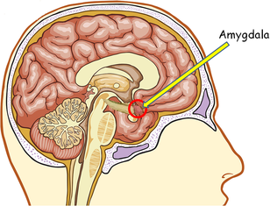

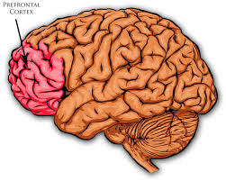
Amygdala & Prefrontal Cortex

Slide 38


Notes:
Deposits
Seek first to understand
Keep promises and kindness
Clarify expectations
Loyalty to the absent
Apologies
SOAR
Straightforward – honesty and integrity
Open – transparent as possible – share knowledge
Accepting – Non Judgmental – hard on the problem soft on the people
Responsible – under promise and over deliver
How do you define it?
How do you demonstrate honesty?
Key attributes of honesty
What are the implications of being honest?
Delivering messages – will others trust you?
SOAR
Straightforward – honesty and integrity
Openness – transparent, sharing caring
Accepting – Separate the problem from the people – hard on the problem soft on the people – avoid the two stinky twins of BO and BS
Responsible – do what you say you are going to do. Under promise and overdeliver

Slide 39
Choices
Confrontation
Collaboration

Slide 40

Escalation
Notes:
Escalation increases negative emotional response
De-escalation increases neutral emotional response
Fields of neuroscience, social work and hostage negotiation

Slide 41

Notes:
Beliefs Cannot Be Changed - Work Towards Common Values
Reframing and Summarizing Engage Cognitive Operators

Slide 42

Center Ourselves First
Calm the fire
Realize you need to be there to help if you are to overcome conflict with collaboration

Slide 43

The Prayer of
St. Francis of Assisi – Religious Tradition
Lord, make me an instrument of your peace.
Where there is hatred, let me sow love;
Where there is injury, pardon;
Where there is darkness, light;
Grant that I may not so much seek
To be consoled as to console;
To be understood as to understand;
To be loved as to love.
For it is in giving that we receive; it is in pardoning that we are born to eternal life.
Notes:
Go over handout on de-escalation
Turn back to the last slide

Slide 44

Neuroplasticity – Ability to Change
Notes:
Neuroplasticity
Ability to change
We all can learn
Based on what we tell ourselves
Happiness
Gratefulness
Label Negative Feelings
Make the decision good enough 80-20
Hugs – Touch People

Slide 45


Emotions
Priorities
Impacts
Notes:
We are 98% emotional and 2% rationale
Work on emotion first
We are predisposed to judge negatively first
We hard wired to approach for food, shelter and sex
We tend to defend against everything else

Slide 47

Notes:
Three sides to an issue: my side, your side and the truth
Issue resolution
Emotional
Factual
How can I help bring peace to those in conflict?

Slide 48

Communication
Notes:
Communication
Attitude
Experts communication and attitude
10% words, 35% tone, 55% body language
Albert Mehrabian
55% body language
37% tone
8% words
Mehrabian Weiner and Ferris communication and attitude
40% vocal and 60% facial

Slide 49
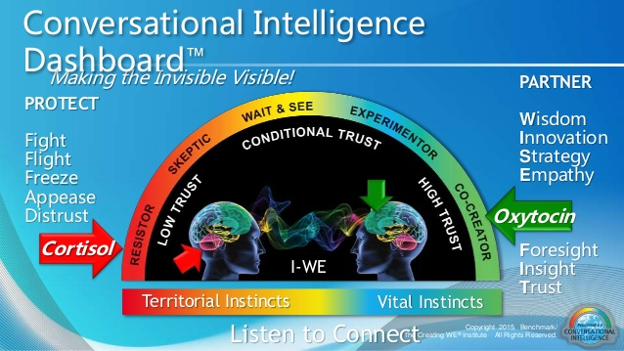

Slide 50

Listening Actively
Notes:
What are barriers to Listening?
Three sides What are they?
How do you overcome them?
Active listening
Discuss and define
Practice an example
Ask how it felt
Men versus women
Differences
Approaches

Slide 51

Active Listening
Paraphrase
Ask open ended questions
Suspend judgment
Summarize
Empathize
Do NOT offer advice

Slide 52
Ways to Support Others
Lead with Compassion
Listen with Empathy
Compassion
Prefrontal Cortex
Empathy
Cerebral Cortex
Calm
Confident
Competent
Understand Their Feelings
Feel their Pain
Take Actions to Address Pain

Slide 53

Negotiation
Notes:
Negotiation
Program on Negotiation from the Harvard Law School
Handout on Negotiation

Slide 54
Official Alternative Dispute Resolution and the IRS
 |  | Stages of IRS Process
 | Pre-Filing | Examination | Collection | Appeals
Type of Taxpayer
LB&I | Compliance Assurance Program | Fast Track Settlement Early Referral to Appeals |  | Post Appeals Mediation
SBSE |  | Same as LB&I | Fast Track Mediation | Post Appeals Mediation
TEGE |  | Early Referral to Appeals

Slide 55

Three Part Process to Get What You Want
You have to decide what you want
You have to ask for it
You have to give three reasons why this is beneficial for them
THEN be quiet AND LISTEN

Slide 56

Yale University’s Most Popular Class – Happiness - Neuroscience
Gratitude 5 minutes a day
Label negative feelings
Make that decision good enough
Appropriate touch with others
Meditation 10 minutes daily

Slide 57

Reduce the Stress Response
Maintain a sense of control
Have a sense of predictability (routine and rituals)
Have a sense of progress (make big projects into smaller elements and provide affirming feedback)

Slide 58
Connecting Relationships
Listening Actively
Educating Judiciously
Leads to Building Bridges and Negotiating Closure

Slide 59
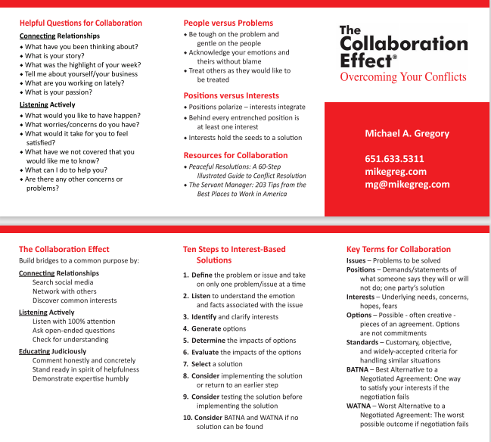

Slide 60
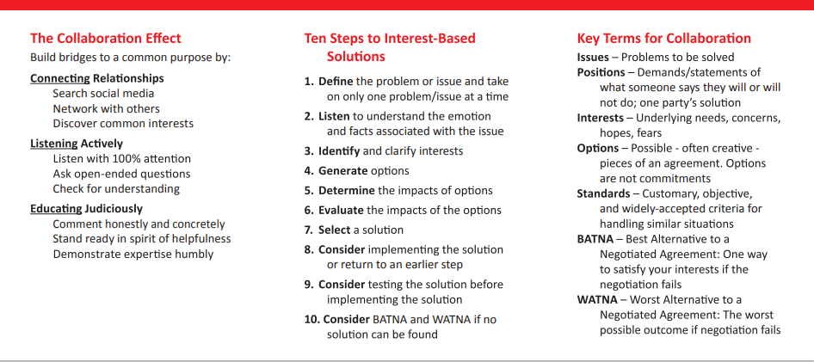

Slide 61
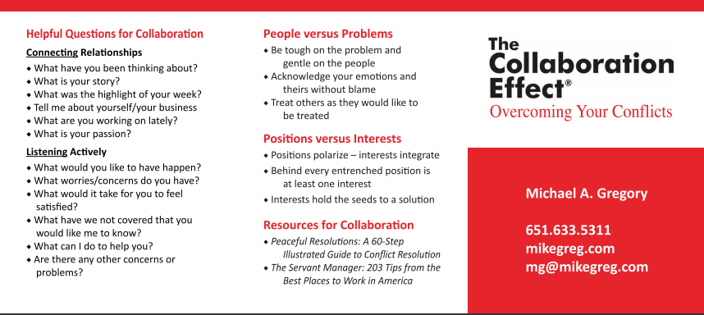

Slide 62



Slide 63
As a Result of Today’s Presentation You Will Be Able to:
Address pertinent changes at the IRS
Describe how the IRS works and how to work with this IRS
Communicate how classification works at the IRS on estate and gift tax audits, and how to avoid an audit
Identify how to work with IRS personnel if audited
Apply The Collaboration Effect and three bonus items

Slide 64
How to Avoid and What to do if Audited by the IRS
Redwood Empire EPC
February 1, 2023
By
Michael Gregory

Slide 65

Please Ask Your Questions?
Michael Gregory
651-633-5311
mg@mikegreg.com

