Slide 1
Cybersecurity update and Trends
Gregory H. Soule, CPA, CISA, CISSP, CFE
Partner

Slide 2

Agenda: about AHP
Current Cybersecurity Trends
NIST Framework

Slide 3
About AHP
Founded in 1993 by three partners from Ernst & Young
160+ employees in eight Michigan locations
  Ann Arbor
  Auburn Hills
  Bay City
  Grand Rapids
  Greater Lansing
  Midland
  Owosso
  Saginaw

Slide 4
Services
Audit and Accounting
Tax Planning, Preparation, and Consulting
Business Consulting
IT Consulting
Forensic Examinations
Retirement and Financial Planning
Employee Benefit Consulting and Administration
SOC 1 and SOC 2

Slide 5
Industries
Financial Institutions
Governmental Entities
Not-For-Profit Organizations
Insurance Companies
Higher Education
Closely Held Businesses
Construction Companies
Employee Benefit Plans
Technology
Manufacturers
Campaign Finance

Slide 6


What Makes ahp unique?
Breadth and Depth of Experience
  “Big Four” Services at the Local Level
Access and Involvement of Partners
and Senior Management
Involvement in Business and Professional Communities
Balance and Commitment to Team Members
  AHP Triangle

Slide 7
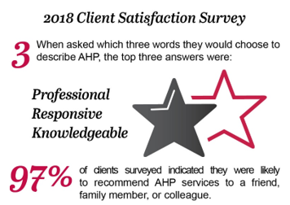
What Makes ahp unique?
Ranked #12 on Crain’s Detroit List of Largest Michigan Accounting Firms

Slide 8
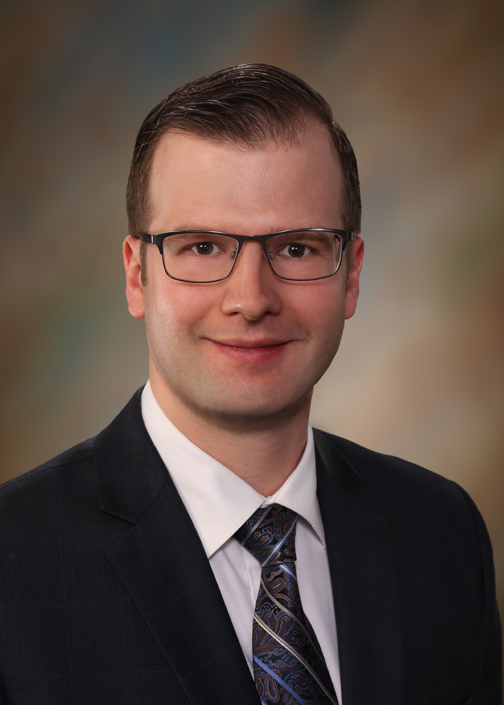
Greg Soule
Partner with Andrews Hooper Pavlik PLC
Central Michigan University
Joined AHP in 2006
CPA – Certified Public Accountant
CISA – Certified Information Systems Auditor
CISSP – Certified Information Systems Security Professional
CFE – Certified Fraud Examiner
Financial Institutions, Insurance Companies, Manufacturers,
Local Governments, Not-For-Profits, Technology
Financial and IT Audits, Consulting, SOC Exams, Forensic Examinations

Slide 9
Agenda:
Current cybersecurity trends

Slide 10
National Cybersecurity Awareness Month
October; 16 Consecutive Years
Effort between Government and Industry
Raise awareness of the importance of cybersecurity
Each year has a theme

Slide 11
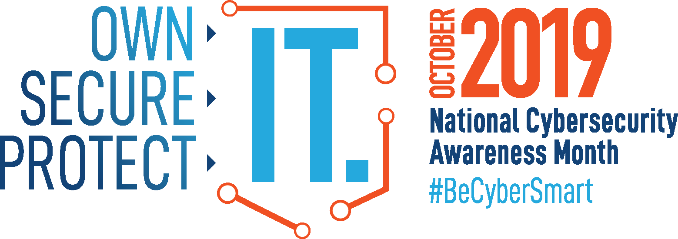
National Cybersecurity Awareness Month
Source – NICCS

Slide 12
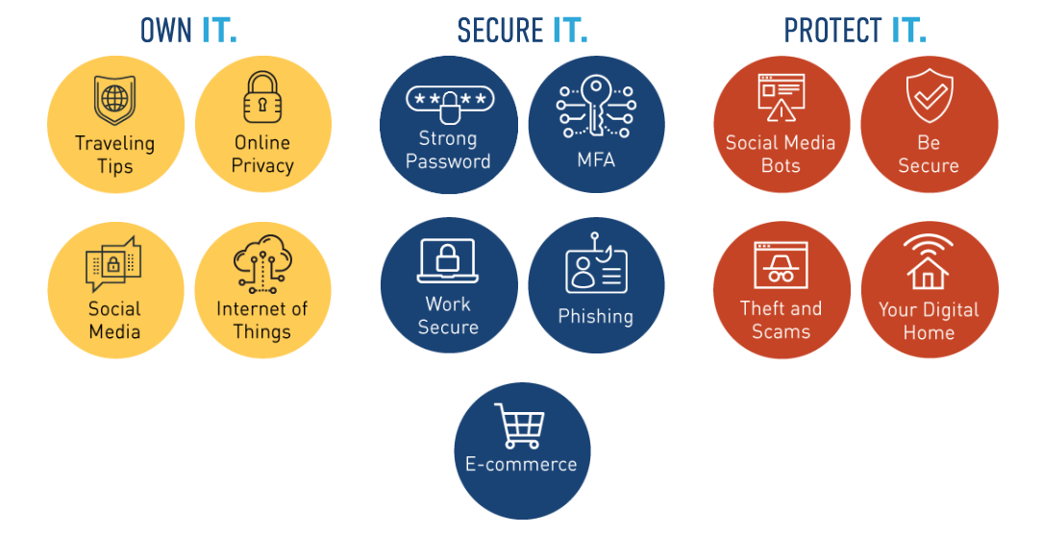
National Cybersecurity Awareness Month
Source – NICCS

Slide 13
Definition
Cybersecurity – The process of protecting information by preventing, detecting, and responding to cyberattacks.

Slide 14
Definition
Cybersecurity – The process of protecting information by preventing, detecting, and responding to cyberattacks.

Slide 15
Cybersecurity
Risk exposures associated with IT:
  Strategic
  Operational
  Compliance
  Reputational
  Financial
  Legal
Major focus of regulatory agencies, boards of directors, management, vendors, and customers.

Slide 16
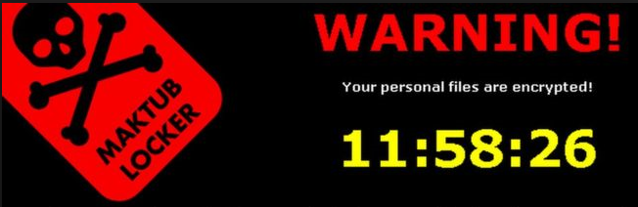
Cybersecurity
Who are the attackers:
  Nation-state
    Intellectual property, political
  Hacktivist
    Political, free speech, human rights, humor
    Defacing of websites
  Organized crime
    Fraud / Theft
  Malicious Insider
    Fraud / Theft
Source: FFIEC

Slide 17
Risk Trends
Risk Trends – General:
  Existing vulnerabilities continue to be exploited
  New platforms create new cyber attack opportunities
  Lines between cyber actors are blurring
  Tactics evolve in response to online behavior
  Trends in malware are evolving
  Global unrest results in changing motivations
FFIEC

Slide 18
Risk Trends
Other Risk Trends:
  AI / Robotic Process Automation (RPA) Malware
  Sandbox-Evading Malware
  Privacy Compliance
  Multi-Factor Authentication
  Nation-State Attacks
  Cryptocurrency and coin-mining attacks
  Cyber Fatigue
Ponemon

Slide 19
Email phishing
  Common way that organizations are compromised
  Targeted – spear phishing
  Typosquatting – swapping or modifying characters
    Combined with brand theft can be very effective
  Most common subject lines: “Payment;” “Request;” “Urgent”
  Most common “lures:” email and Office 365 credential harvesting and financial institution phishing
Source: 2019 Proofpoint Human Factor Report

Slide 20
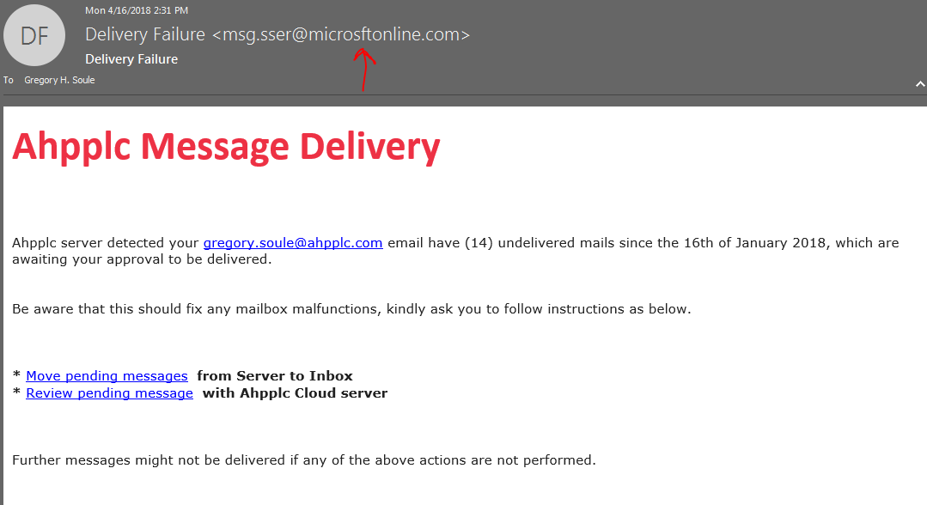
Email phishing

Slide 21
Risk Trends
Ransomware
  Malicious software
  Encrypts all files
  Demands payment in cryptocurrency to recover files
  Ransom is often a standard amount
    Geographic area?
  Becoming more targeted and destructive
  FBI Public Service Announcements

Slide 22

ransomware
Ransomware
  2019 average ransomware cost: $36,295
    Including cost of business disruption
  Average downtime: 9.6 days
  96% of organizations receive a working decryption tool
  8% of decrypted data is lost
  Estimated to have global impact of $11.9 billion in 2019
Source: KnowBe4 and Coveware Q2 2019 Ransomware Marketplace Report

Slide 23
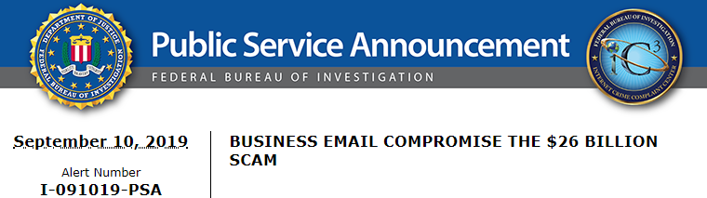
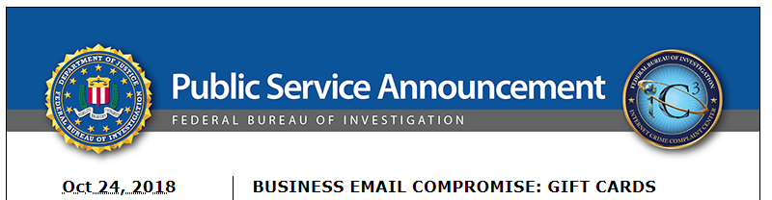
Business Email Compromise
Wire Transfers --- CEO fraud
Now --- gift card scams
HR Data – Payroll, SSNs
CEO/CFO Masquerading
October 2013 – July 2019:
  $26.2 billion losses globally
  163,349 incidents globally

Slide 24
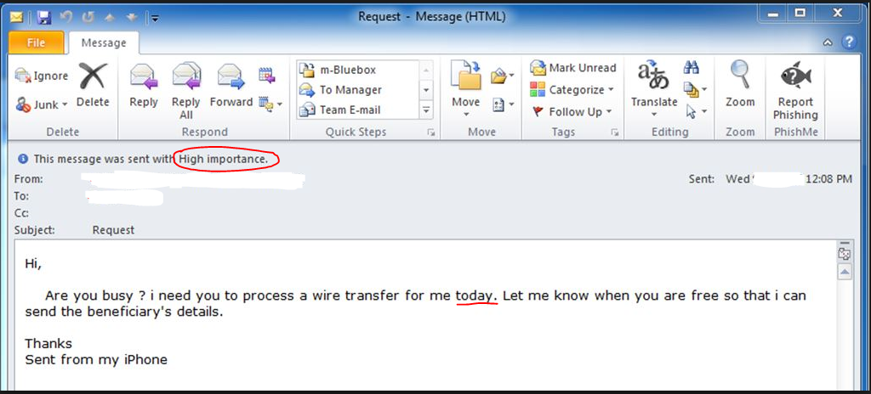
Business email compromise

Slide 25
Agenda:
NIST Framework

Slide 26
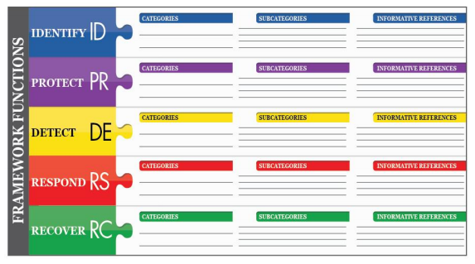
Definition
NIST Cybersecurity Framework Functions:
Identify
Protect
Detect
Respond
Recover
Source – NIST CSF

Slide 27
NIST CSF
Identify – Develop an organizational understanding to manage cybersecurity risk to systems, people, assets, data, and capabilities.
Source – NIST CSF
Notes:
Identify – Develop an organizational understanding to manage cybersecurity risk to systems, people, assets, data, and capabilities.
The activities in the Identify Function are foundational for effective use of the Framework. Understanding the business context, the resources that support critical functions, and the related cybersecurity risks enables an organization to focus and prioritize its efforts, consistent with its risk management strategy and business needs. Examples of outcome Categories within this Function include: Asset Management; Business Environment; Governance; Risk Assessment; and Risk Management Strategy.

Slide 28
NIST CSF
Identify – Plain English
Make a list of all equipment, software, and data that you use, including servers, PCs, laptops, smartphones, tablets, and point-of-sale devices.
Create a cybersecurity plan that addresses roles and responsibilities of employees, vendors, and outlines steps you take to protect against an attack.
Source – FTC
Notes:
Identify – Develop an organizational understanding to manage cybersecurity risk to systems, people, assets, data, and capabilities.
The activities in the Identify Function are foundational for effective use of the Framework. Understanding the business context, the resources that support critical functions, and the related cybersecurity risks enables an organization to focus and prioritize its efforts, consistent with its risk management strategy and business needs. Examples of outcome Categories within this Function include: Asset Management; Business Environment; Governance; Risk Assessment; and Risk Management Strategy.

Slide 29
NIST CSF
Protect – Develop and implement appropriate safeguards to ensure delivery of critical services.
Source – NIST CSF
Notes:
Protect – Develop and implement appropriate safeguards to ensure delivery of critical services.
The Protect Function supports the ability to limit or contain the impact of a potential cybersecurity event. Examples of outcome Categories within this Function include: Identity Management and Access Control; Awareness and Training; Data Security; Information Pro

Slide 30
NIST CSF
Protect – Plain English
Develop and Implement IT Controls
  Encrypt data at rest and in transit (i.e. email)
  Take regular backups, and monitor and test them
  Use antivirus and security software, and update automatically
  Train your employees to think about security
  Update and patch your computers
Source – FTC

Slide 31
NIST CSF
Detect – Develop and implement appropriate activities to identify the occurrence of a cybersecurity event.
Source – NIST CSF
Notes:
Detect – Develop and implement appropriate activities to identify the occurrence of a cybersecurity event.
The Detect Function enables timely discovery of cybersecurity events. Examples of outcome Categories within this Function include: Anomalies and Events; Security Continuous Monitoring; and Detection Processes

Slide 32
NIST CSF
Detect – Plain English
Monitor your computers for unauthorized access, devices (i.e. USB drives) and software
Check the network for unauthorized connections or users
Investigate and follow up on any unusual activities
Source – FTC

Slide 33
NIST CSF
Respond – Develop and implement appropriate activities to take action regarding a detected cybersecurity event.
Source – NIST CSF
Notes:
Respond – Develop and implement appropriate activities to take action regarding a detected cybersecurity incident.
The Respond Function supports the ability to contain the impact of a potential cybersecurity incident. Examples of outcome Categories within this Function include: Response Planning; Communications; Analysis; Mitigation; and Improvements.

Slide 34
NIST CSF
Respond – Plain English
Have a plan to:
  Notify customers, employees, and others whose data may be at risk
  Keep business operations up and running while investigating
  Report the attack to law enforcement and other authorities
  Investigate and contain an attack
  Update your cybersecurity plan based on lessons learned
  Respond to other events that may put data at risk
Source – FTC

Slide 35
NIST CSF
Recover – Develop and implement appropriate activities to maintain plans for resilience and to restore any capabilities or services that were impaired due to a cybersecurity incident.
Source – NIST CSF
Notes:
Recover – Develop and implement appropriate activities to maintain plans for resilience and to restore any capabilities or services that were impaired due to a cybersecurity incident.
The Recover Function supports timely recovery to normal operations to reduce the impact from a cybersecurity incident. Examples of outcome Categories within this Function include: Recovery Planning; Improvements; and Communications.

Slide 36
NIST CSF
Recover – Plain English
Repair and restore the parts of your network that were affected
Keep employees and customers informed of your response and recovery activities
Source – FTC

Slide 37
Contact Information
Gregory H. Soule, CPA, CISA, CISSP, CFE
Partner
Andrews Hooper Pavlik PLC
691 N. Squirrel Road, Suite 280
Auburn Hills, MI 48326
p: 248.340.6050
e: gregory.soule@ahpplc.com
www.ahpplc.com

Slide 38
Contact Information
This presentation was produced in connection with an educational and informational program. It represents the statements and views of the author(s) alone and does not necessarily represent the official policies or positions of Andrews Hooper Pavlik PLC, its partners, or any sponsor of this program. This presentation is not intended to be, nor should it be construed as constituting tax, accounting, auditing, security, or consulting advice with regard to specific cases, transactions, or situations used by the author(s).
Any accounting, business, or tax advice contained in this presentation, including attachments and enclosures, is not intended as a thorough analysis of specific issues, nor a substitute for a formal opinion, nor was it written to be used to avoid tax related penalties.
Any brand names and/or logos displayed or discussed in this presentation are the property of their respective owners, are used for identification purposes only, and do not imply endorsement by/of or affiliation with AHP.

